Slide 1
BCCA figures
March 13 2025

Slide 2
Data % to report
X2.1.Flow.Type n prop
<chr> <int> <dbl>
1 Biotic 113 0.551
2 Human movement 21 0.102
3 Physical 38 0.185
4 Sociocultural 33 0.161

Slide 3
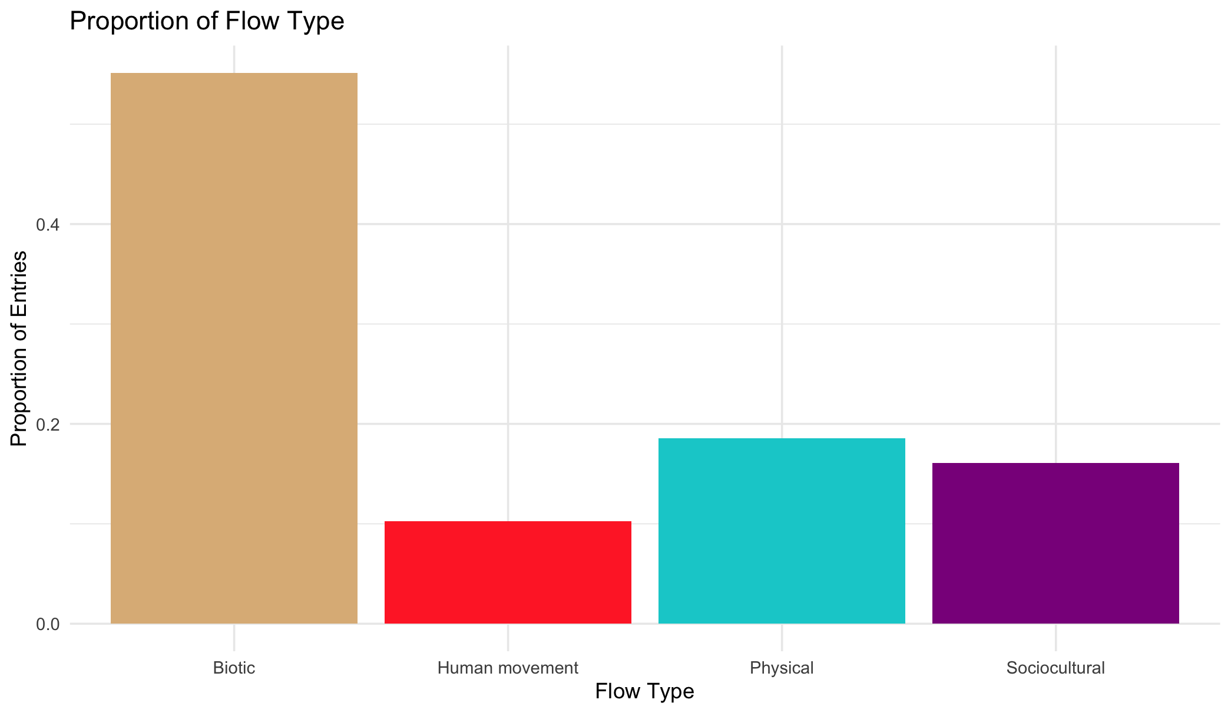

Slide 4
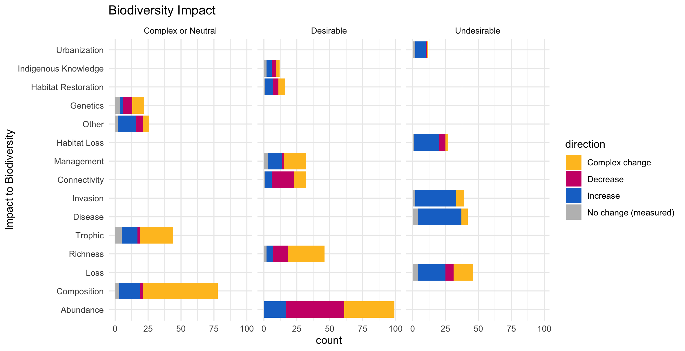

Slide 5
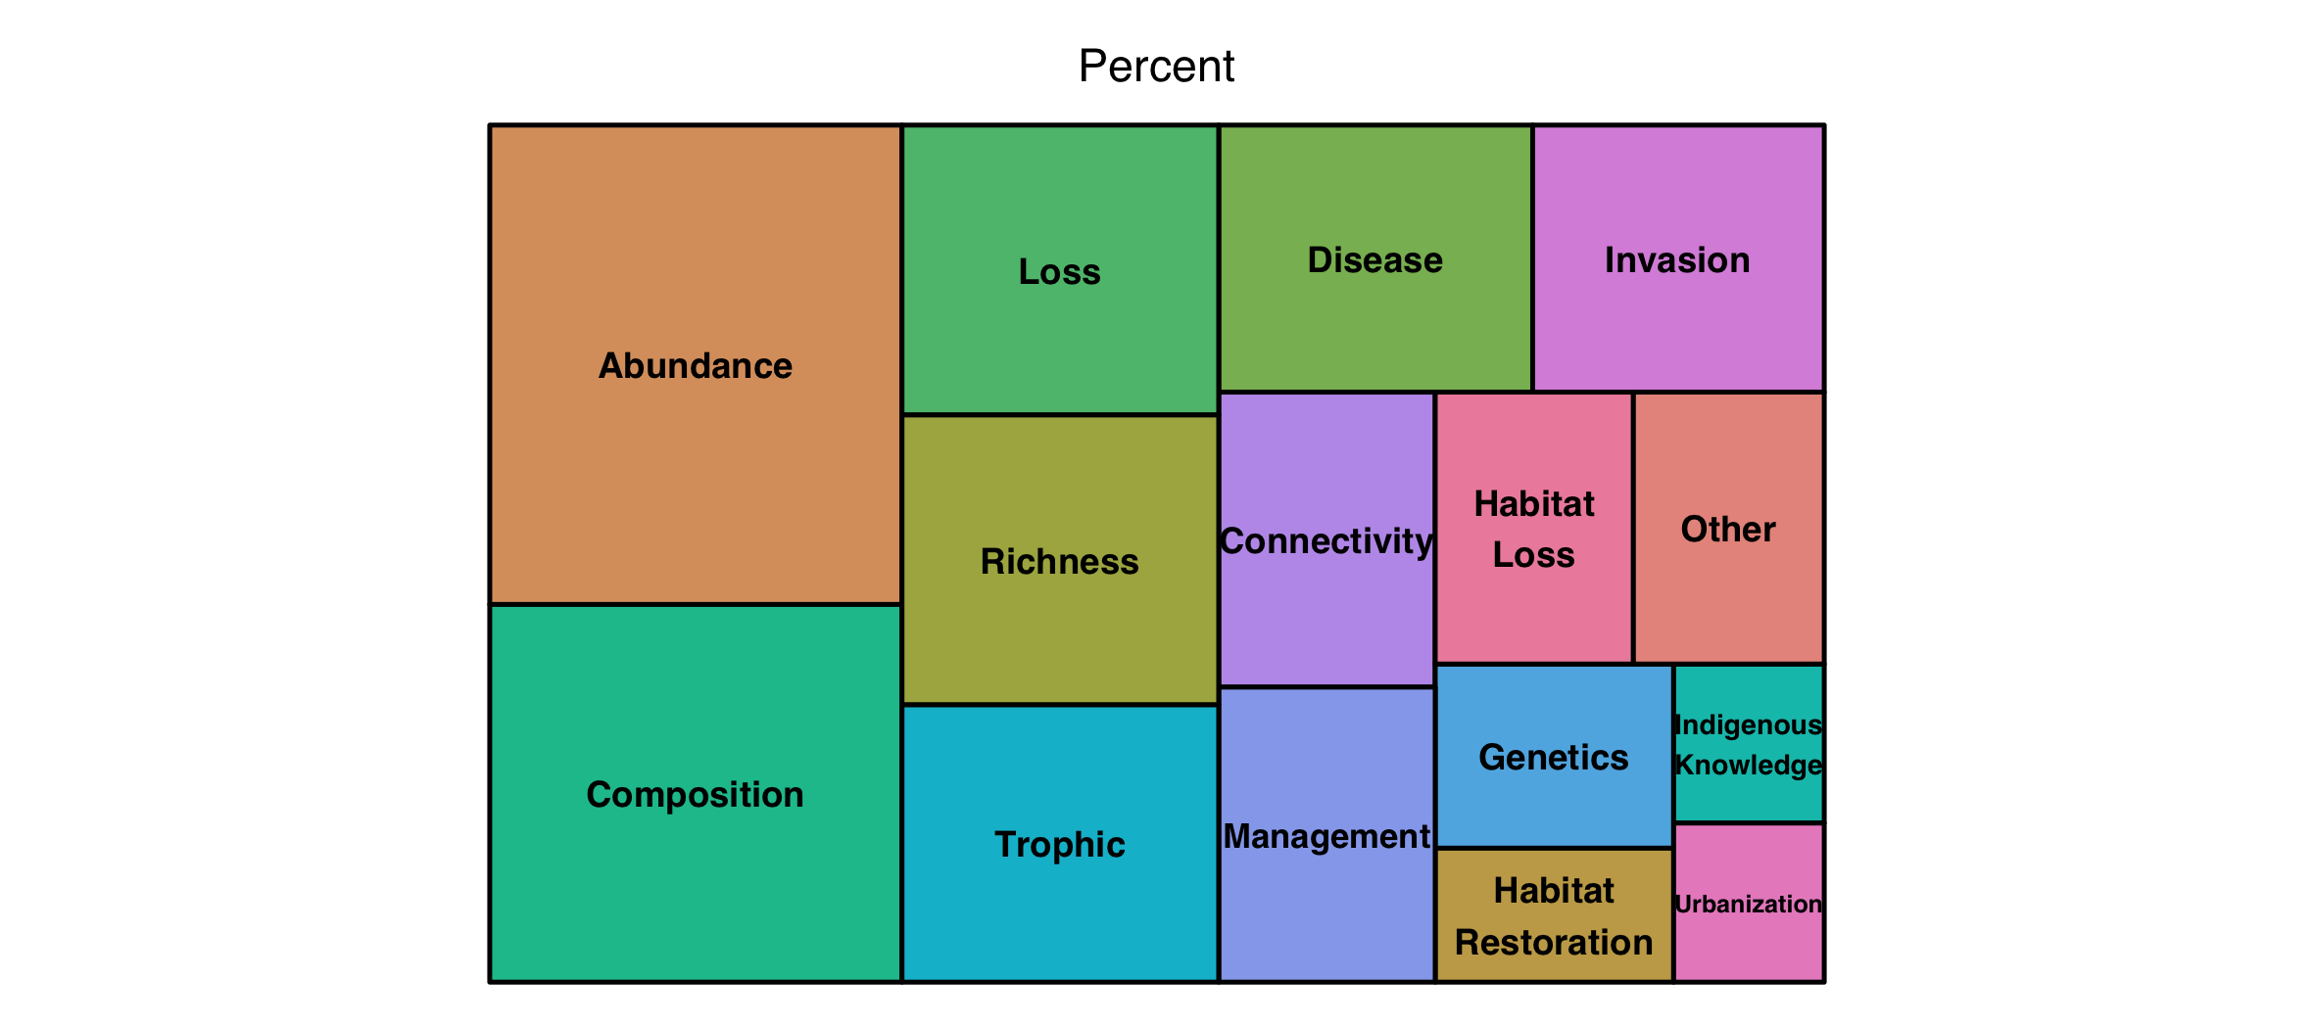

Slide 6
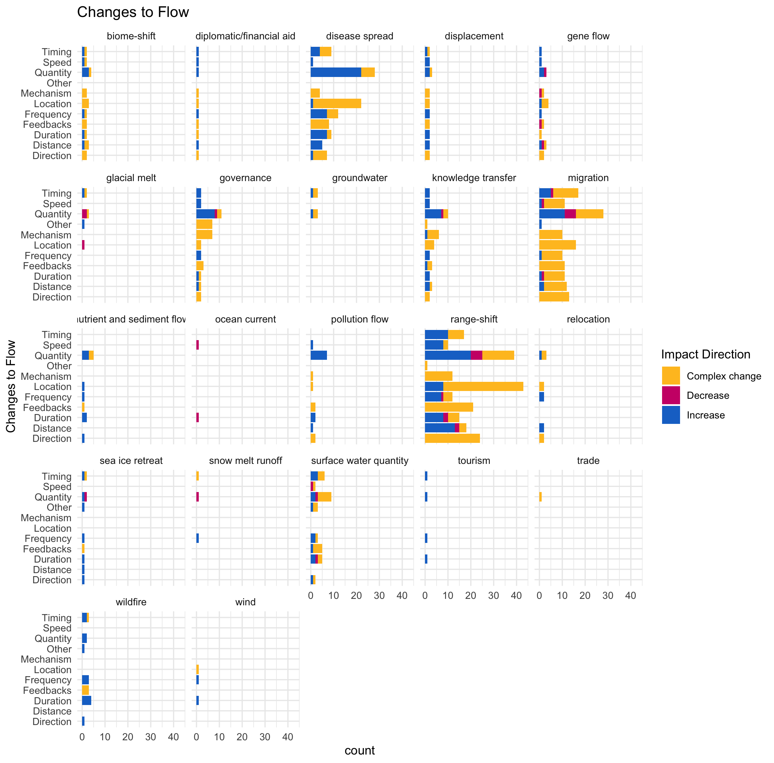

Slide 7
Multiple flows
Another.Flow. n prop
1 No 168 0.820
2 Yes 37 0.180

Slide 8
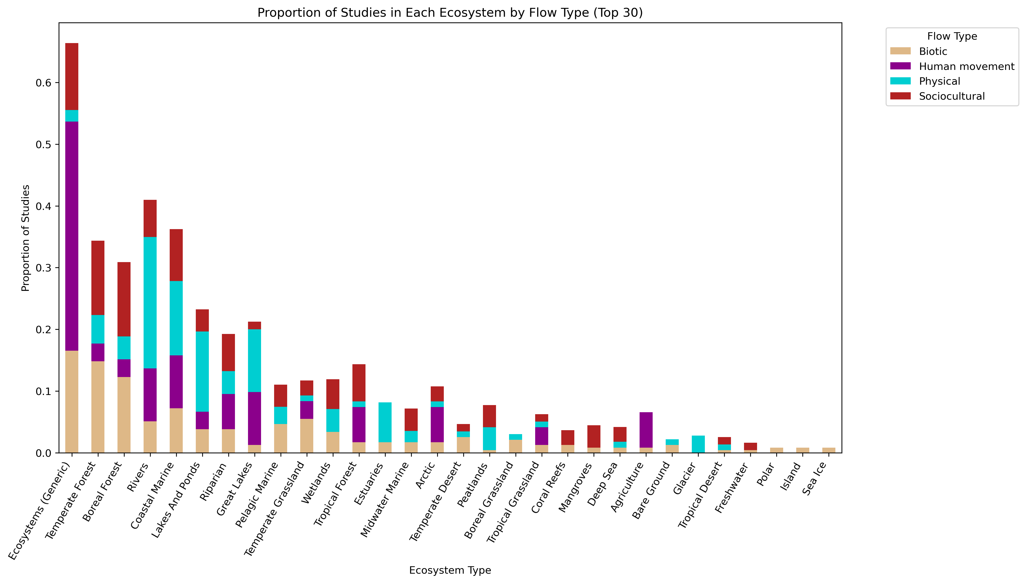
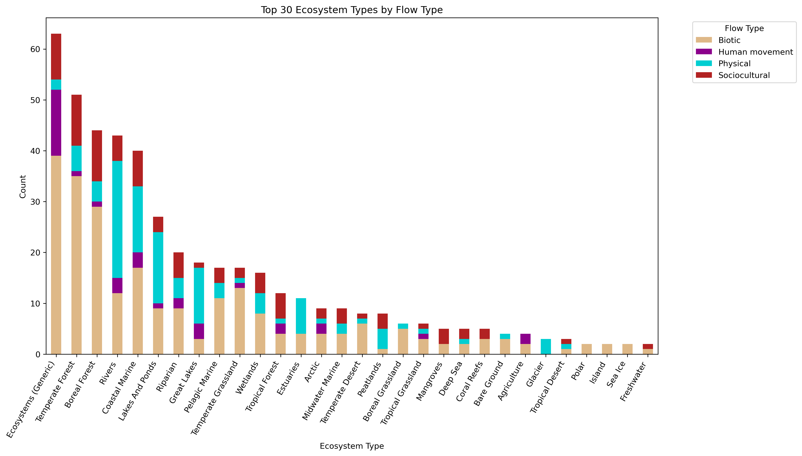

Slide 9
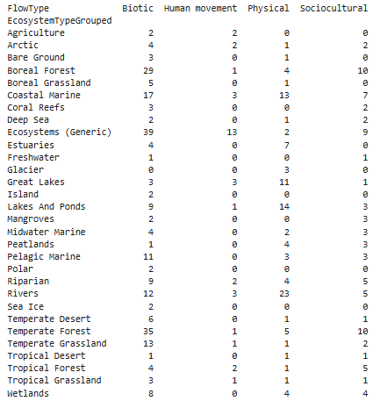
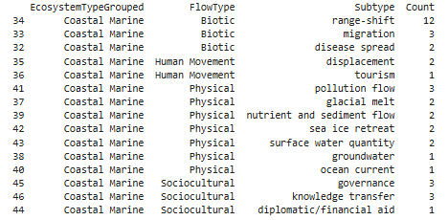

Slide 11
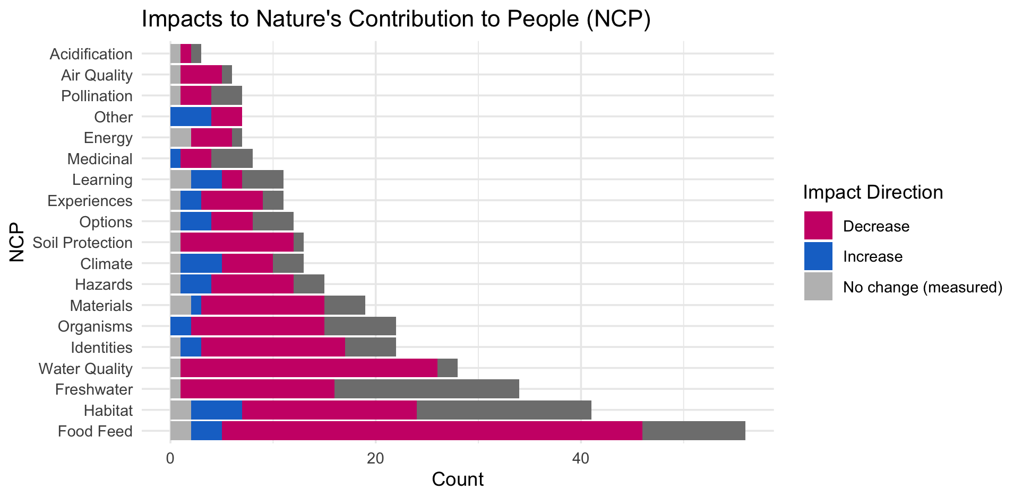

Slide 13
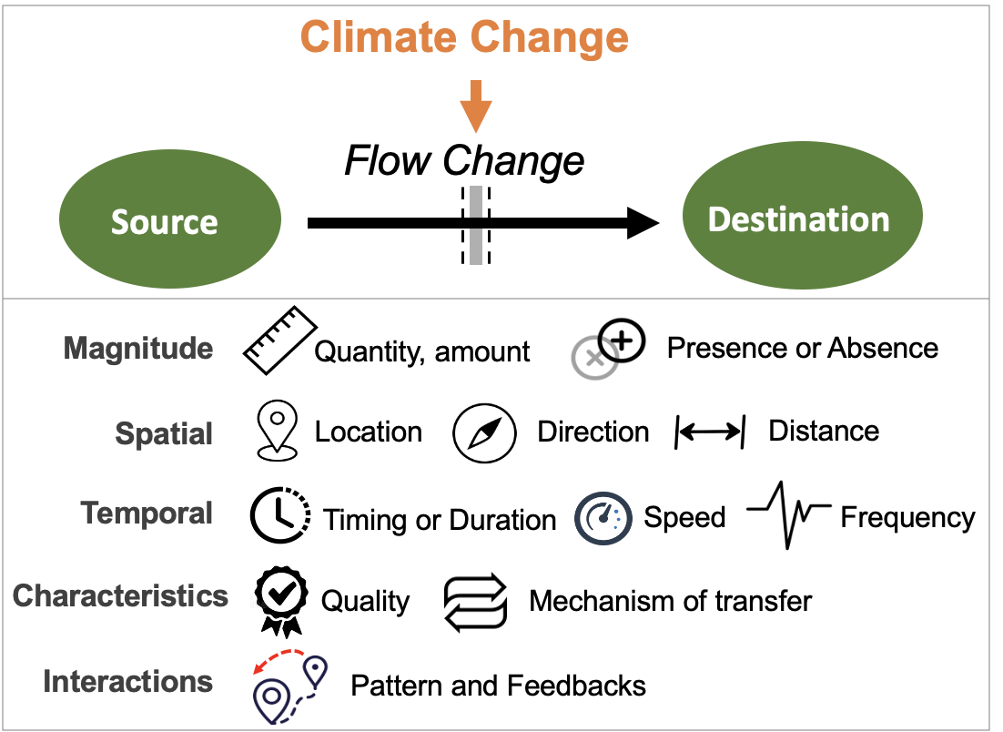
Most common paths
Climate change →

Slide 14
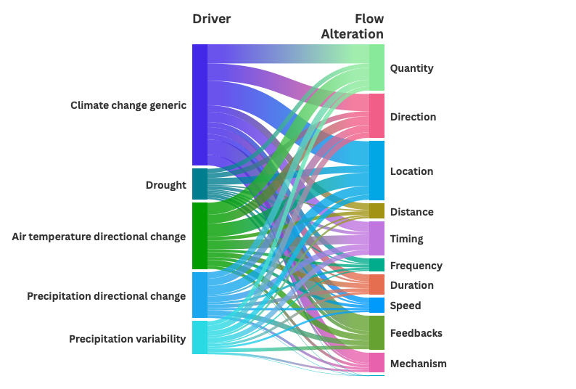

Slide 15
HWB studies count
# Cohesion Justice Other Relational Welfare
# 18 21 7 31 76

Slide 16
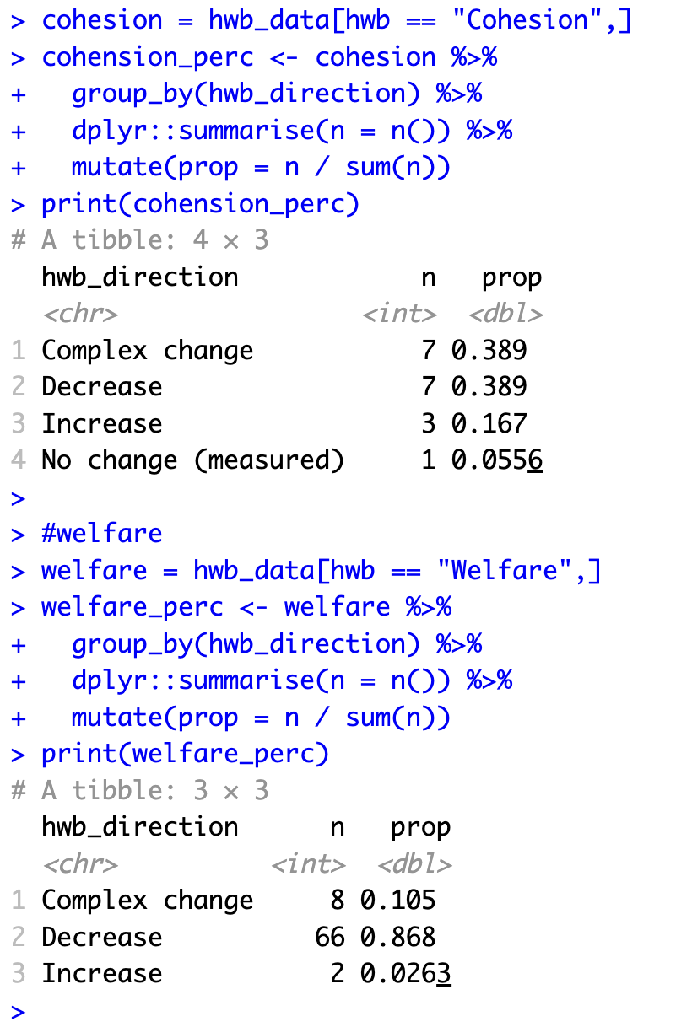
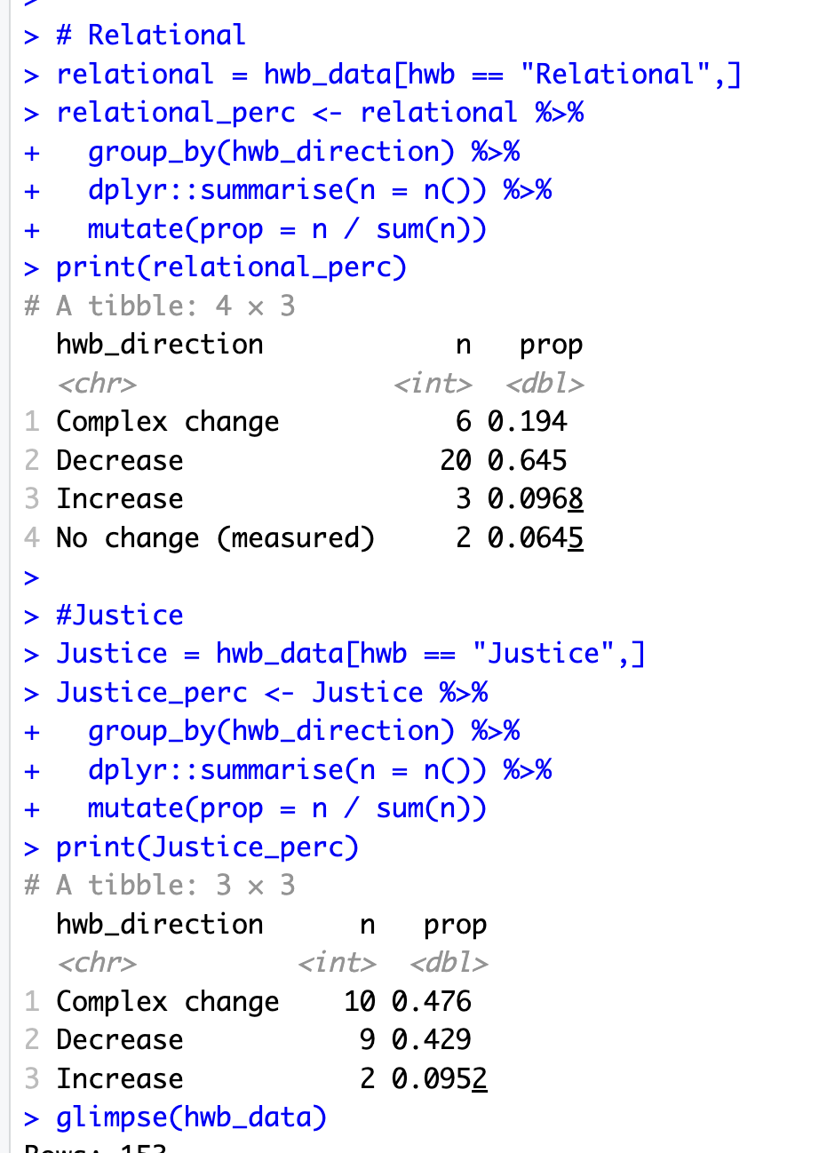

Slide 17
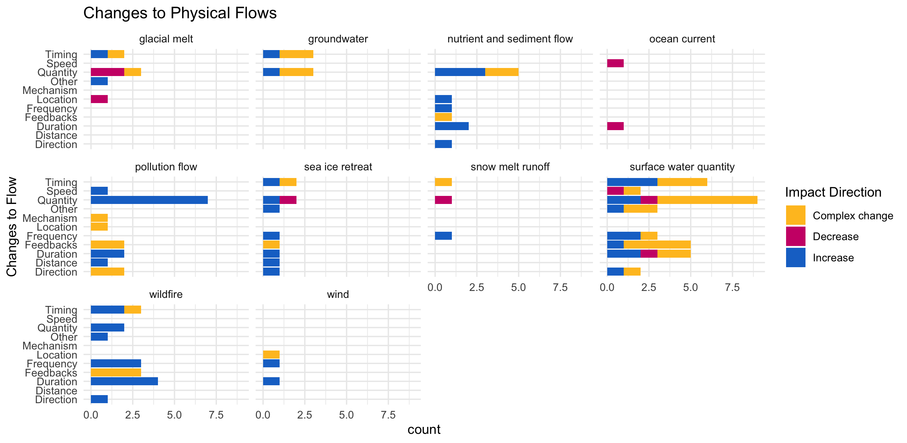

Slide 18
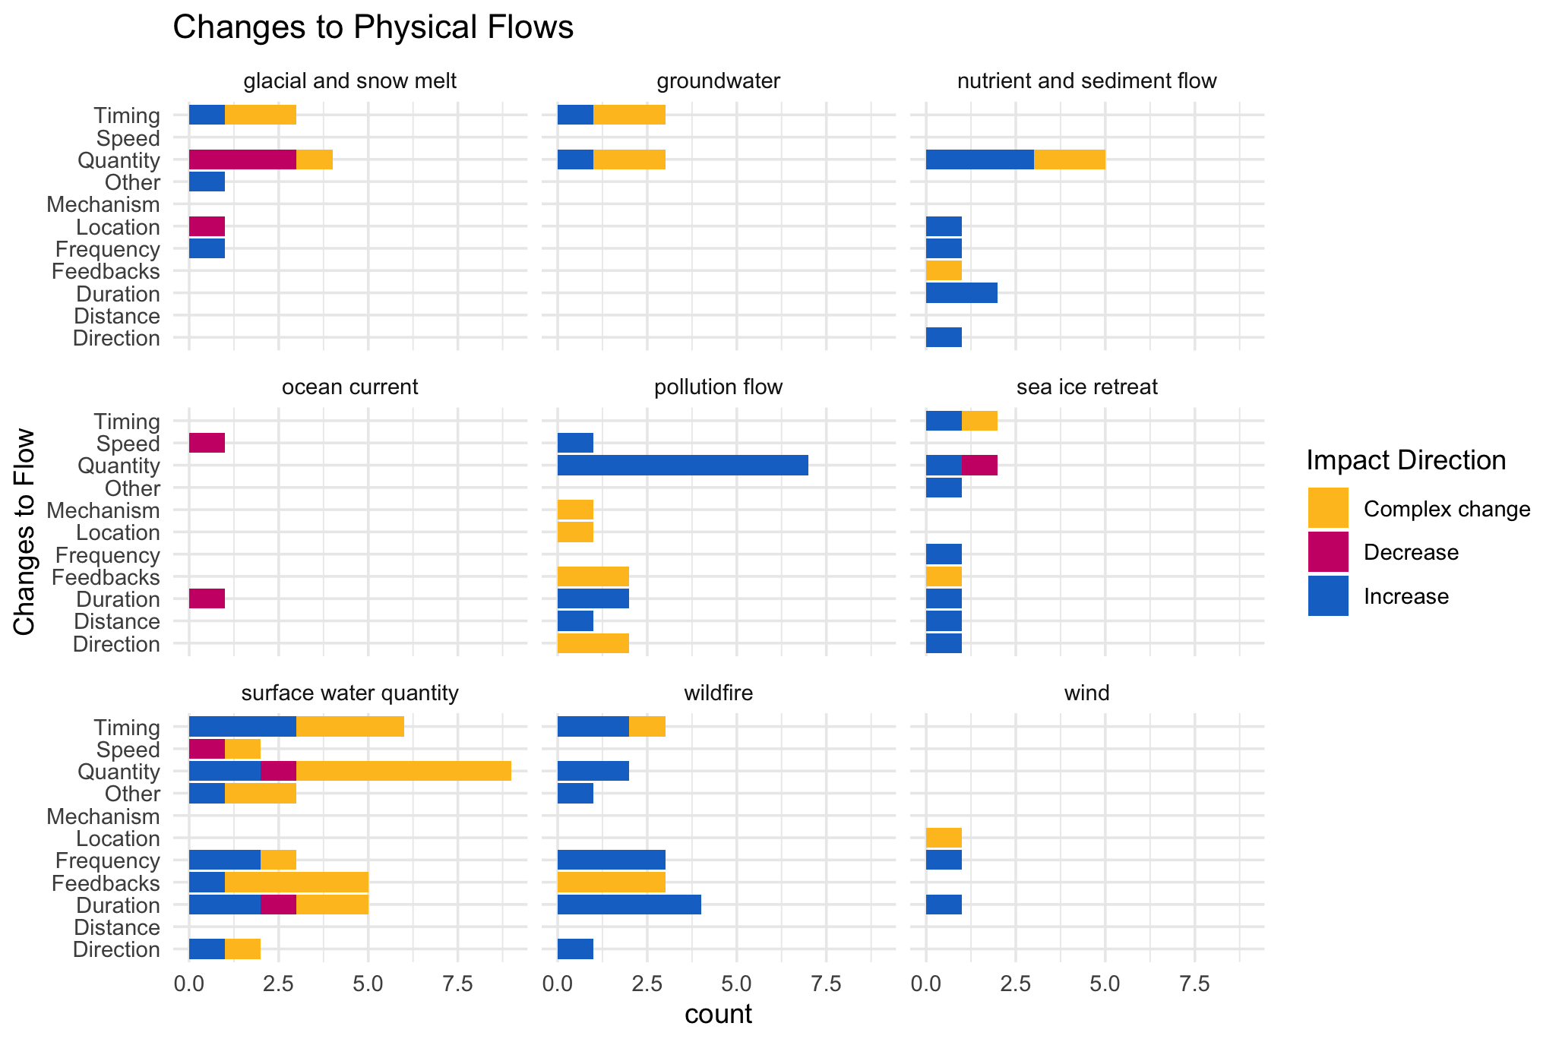

Slide 19
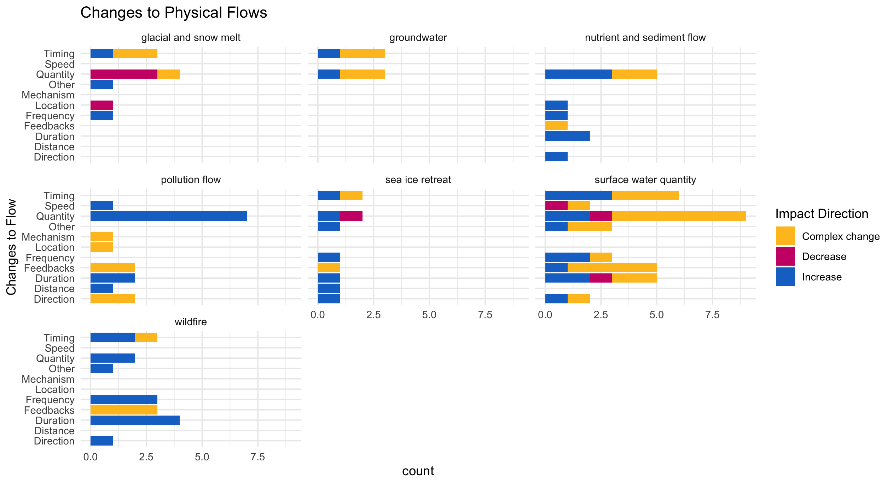

Slide 20
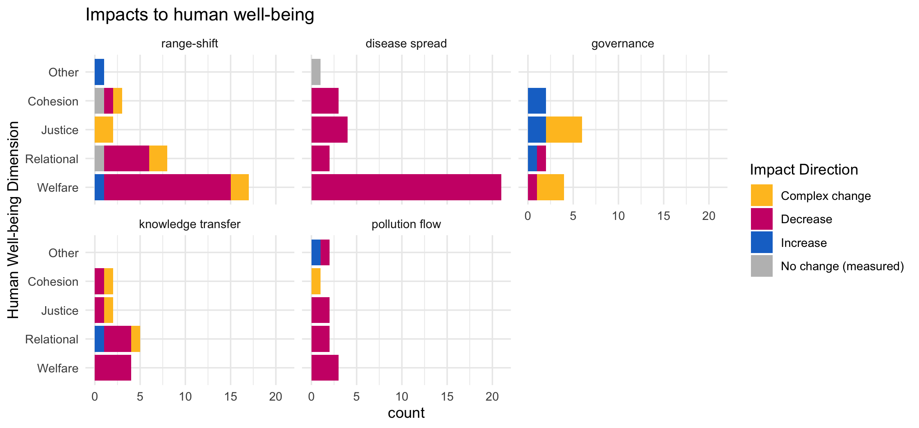

Slide 21
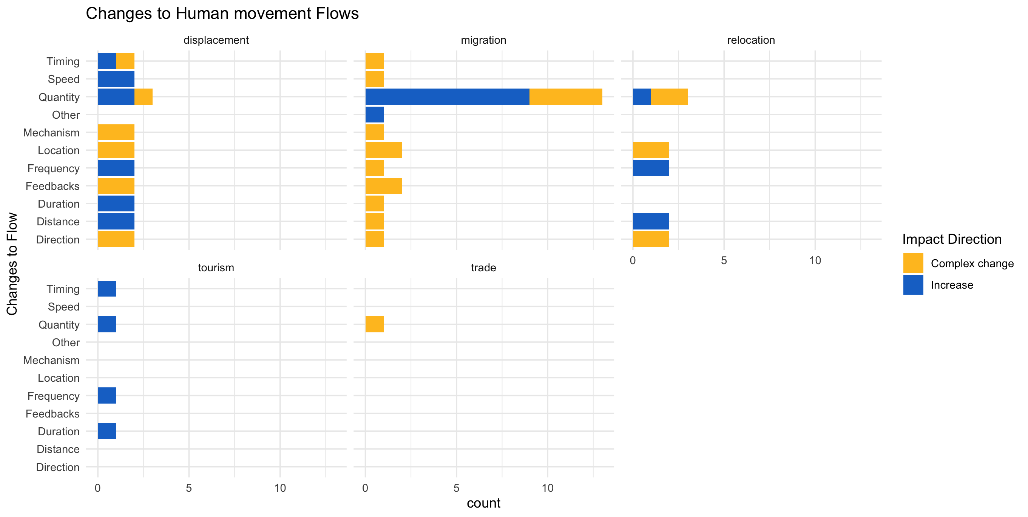

Slide 22
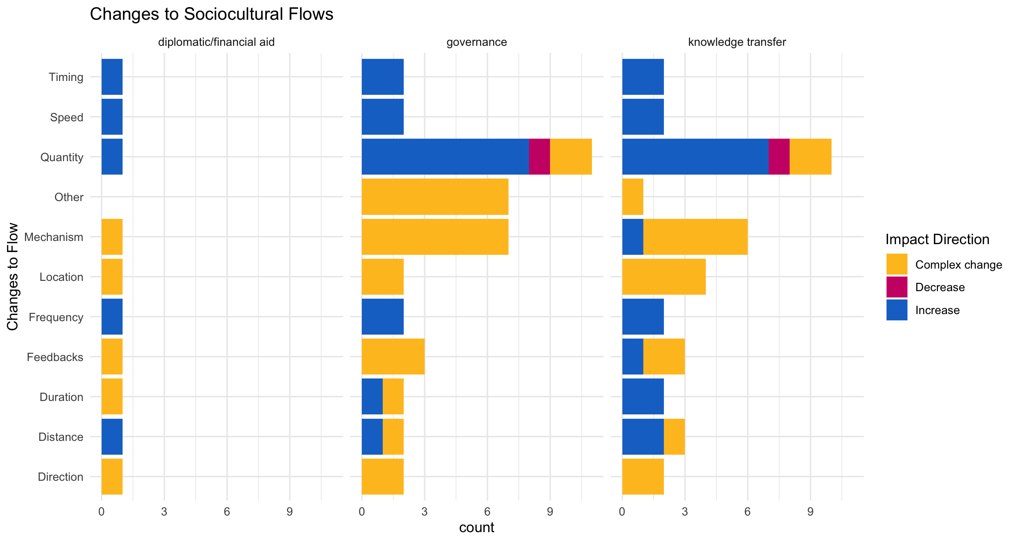

Slide 23
hwb_direction n prop
<chr> <int> <dbl>
1 Complex change 8 0.105
2 Decrease 66 0.868
3 Increase 2 0.0263

Slide 24
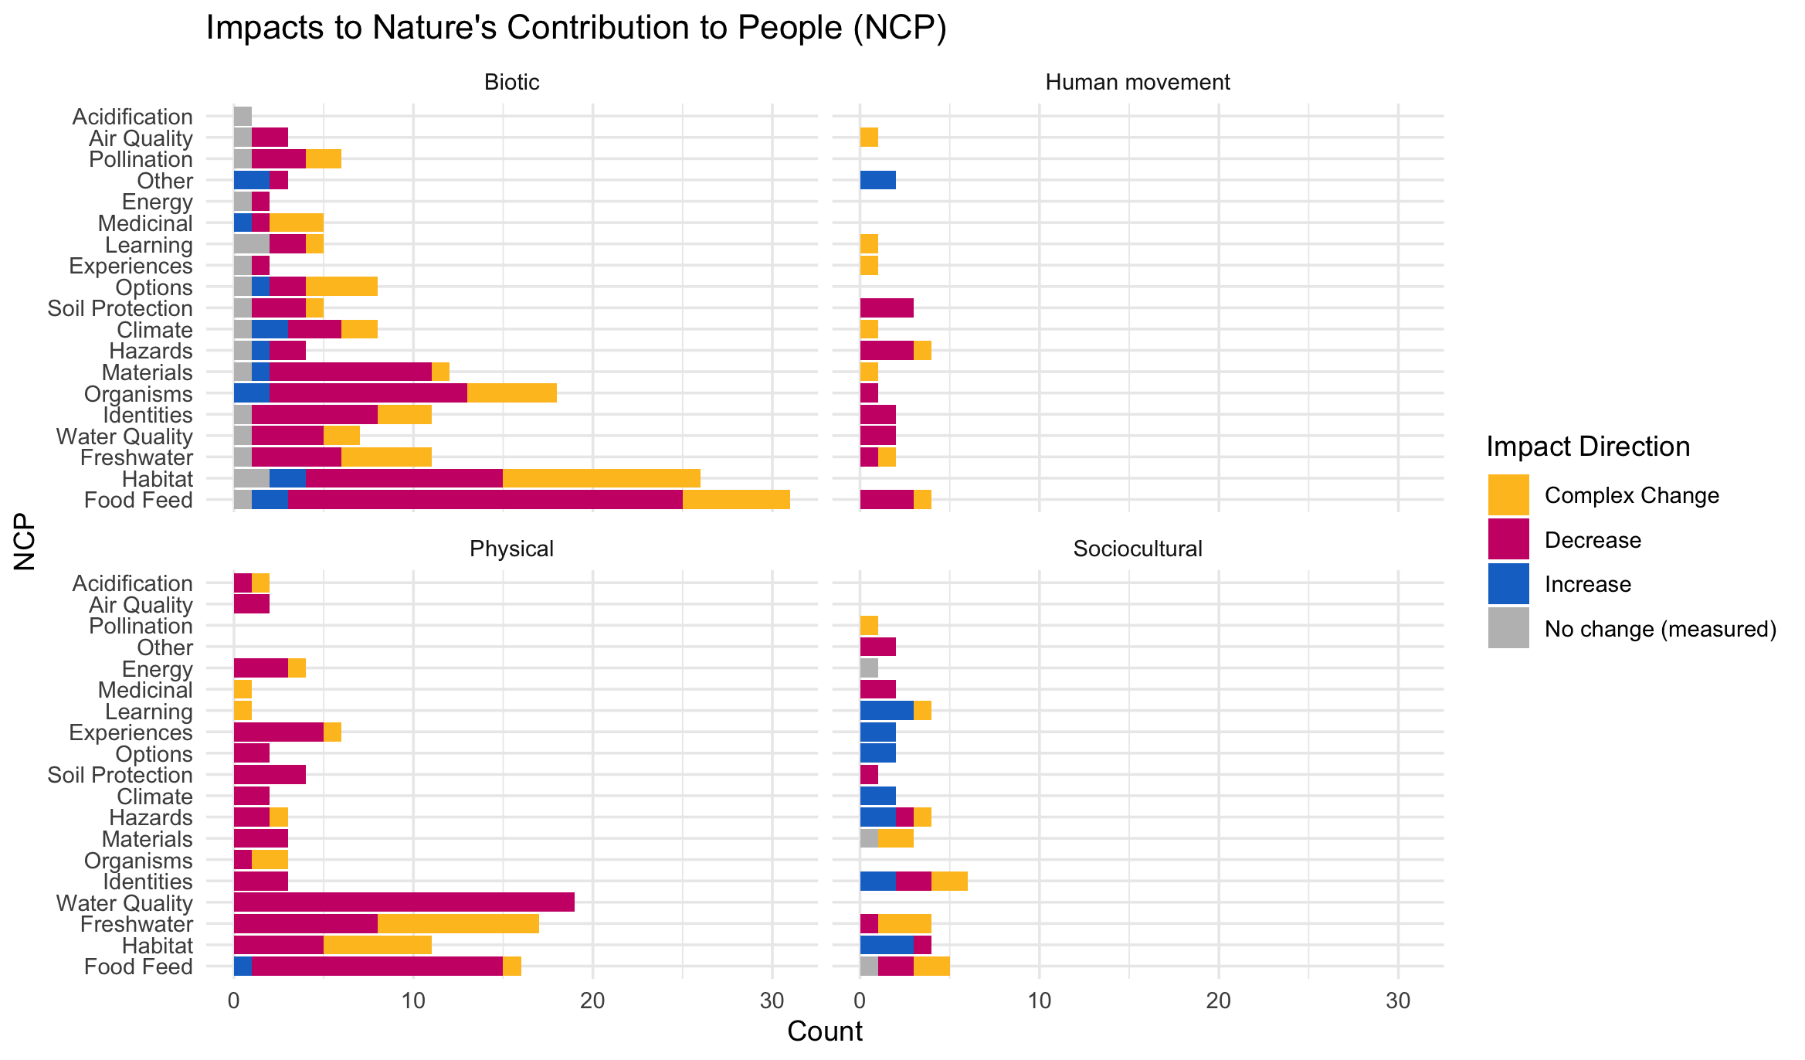

Slide 25
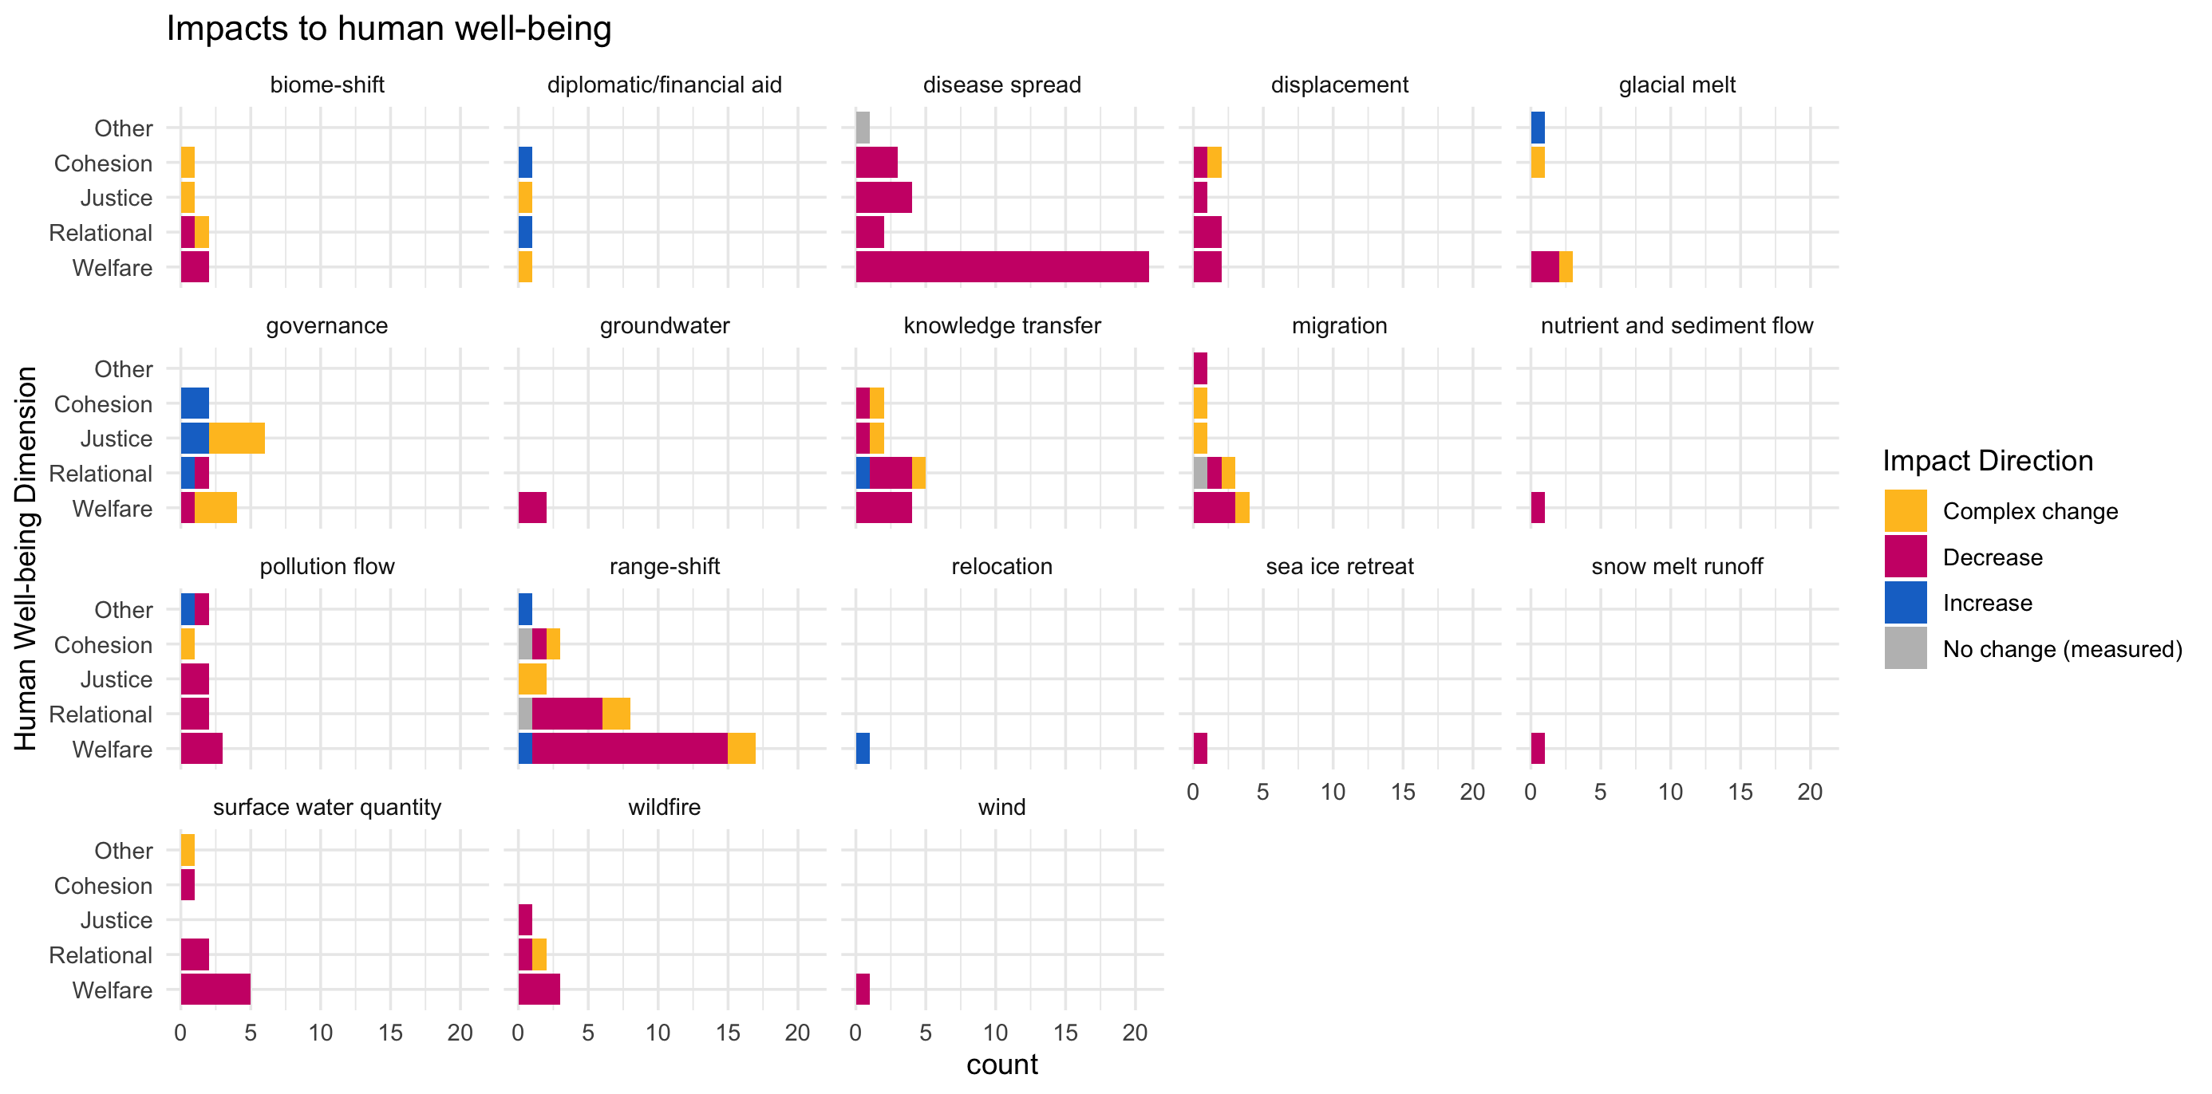

Slide 26
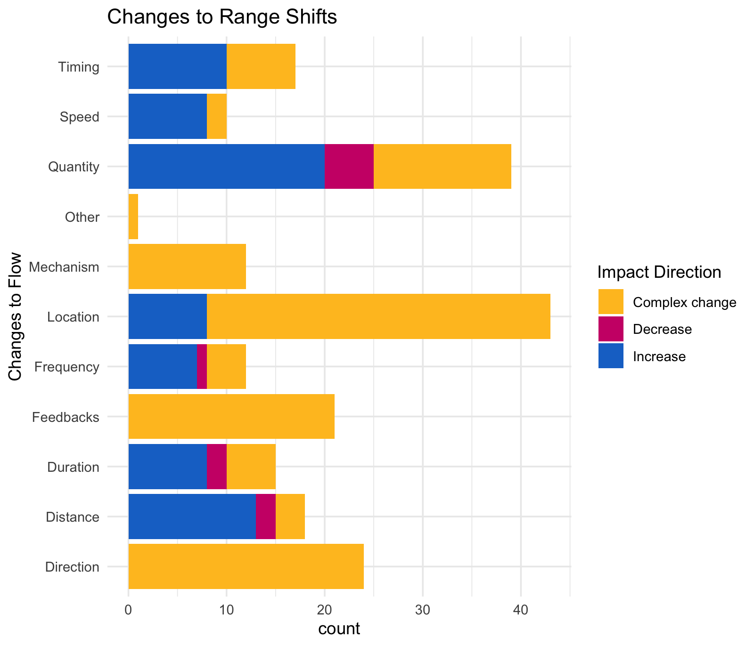

Slide 27
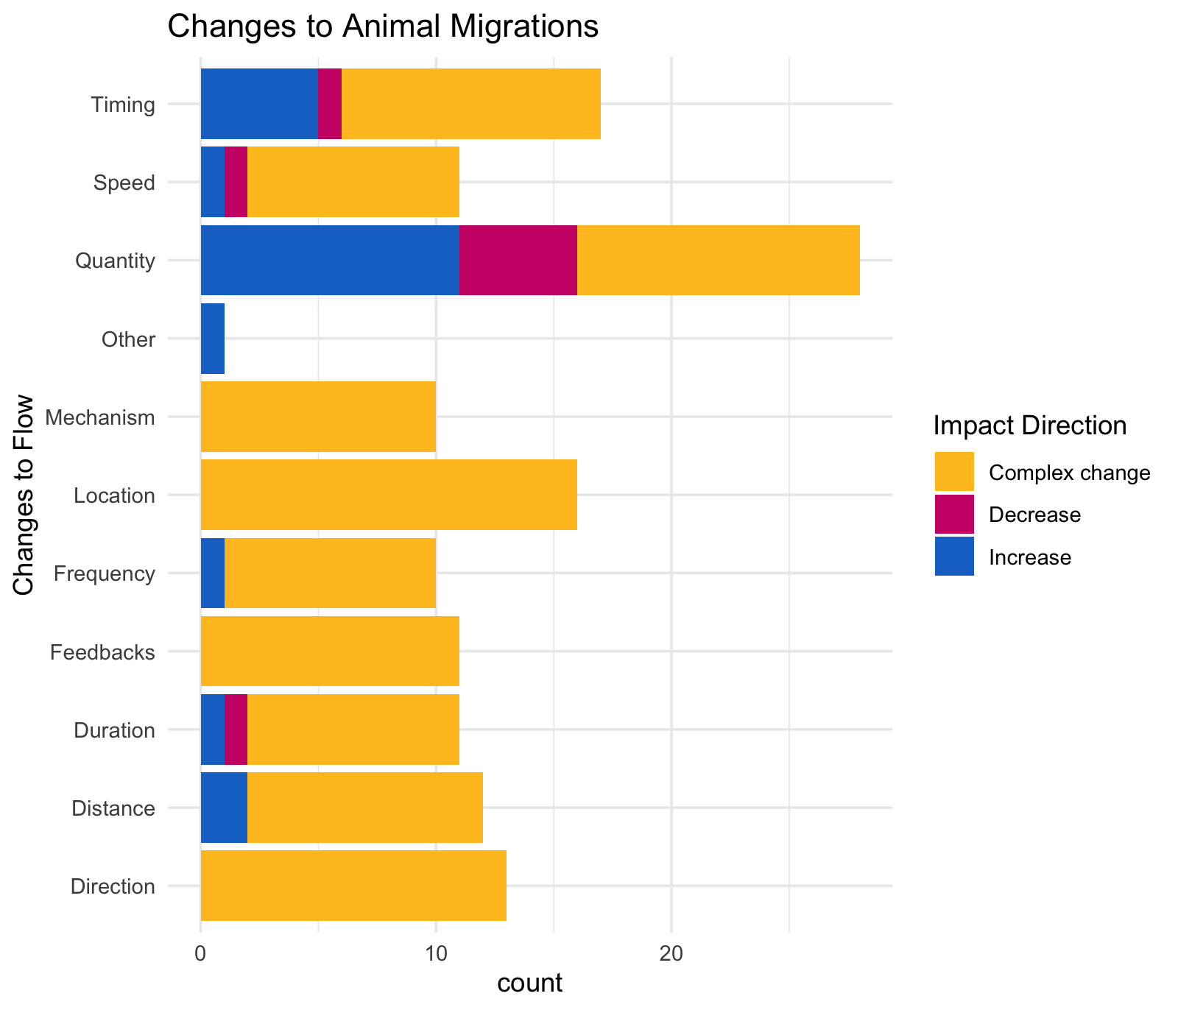

Slide 28
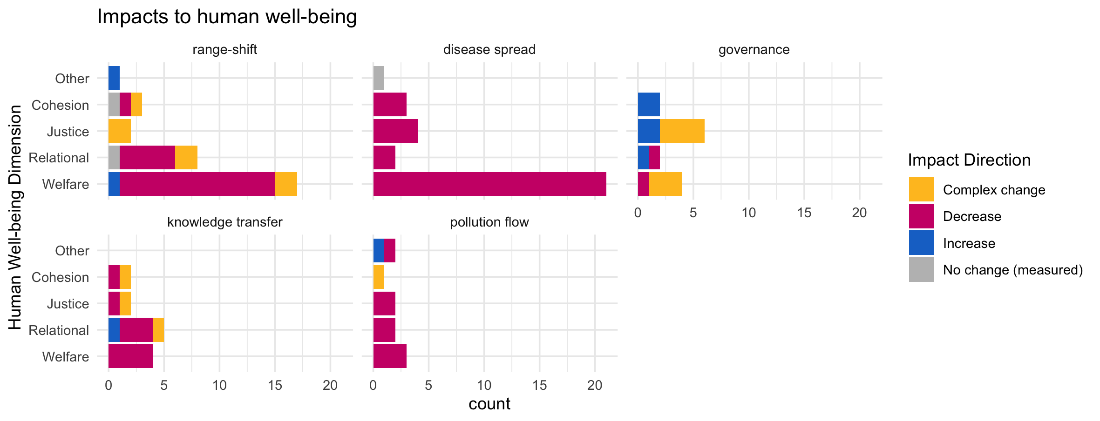

Slide 29
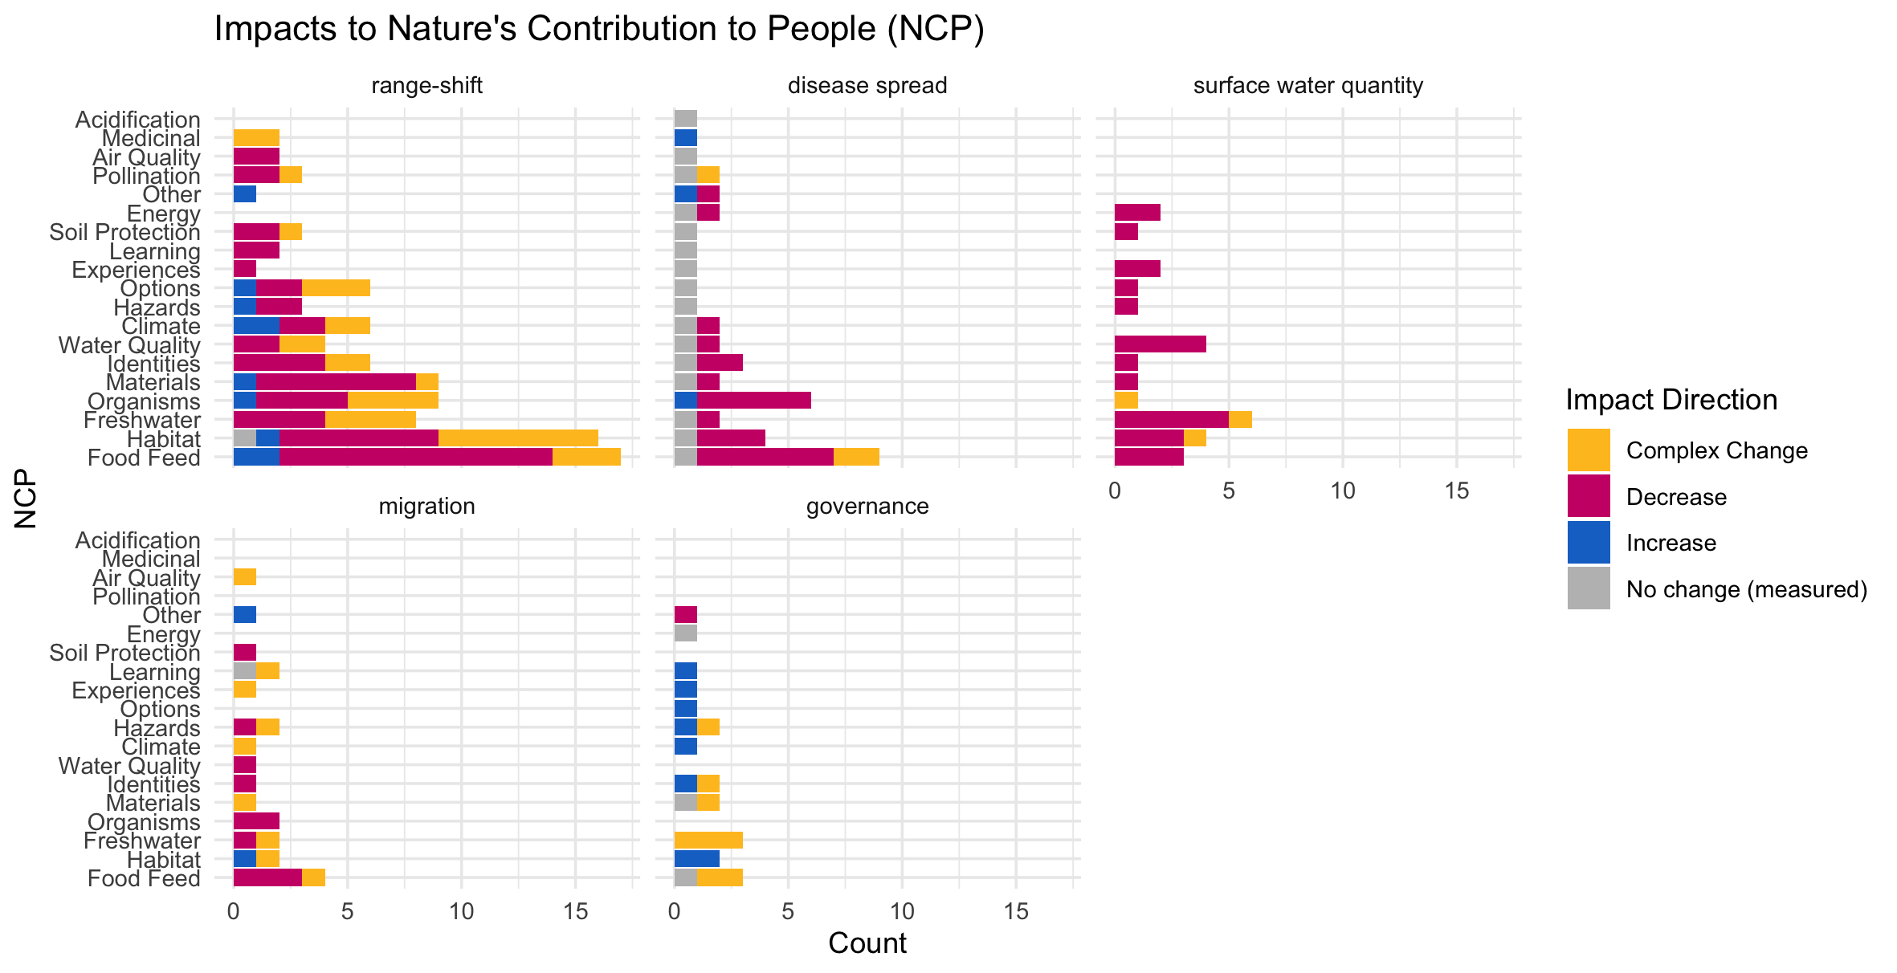

Slide 30
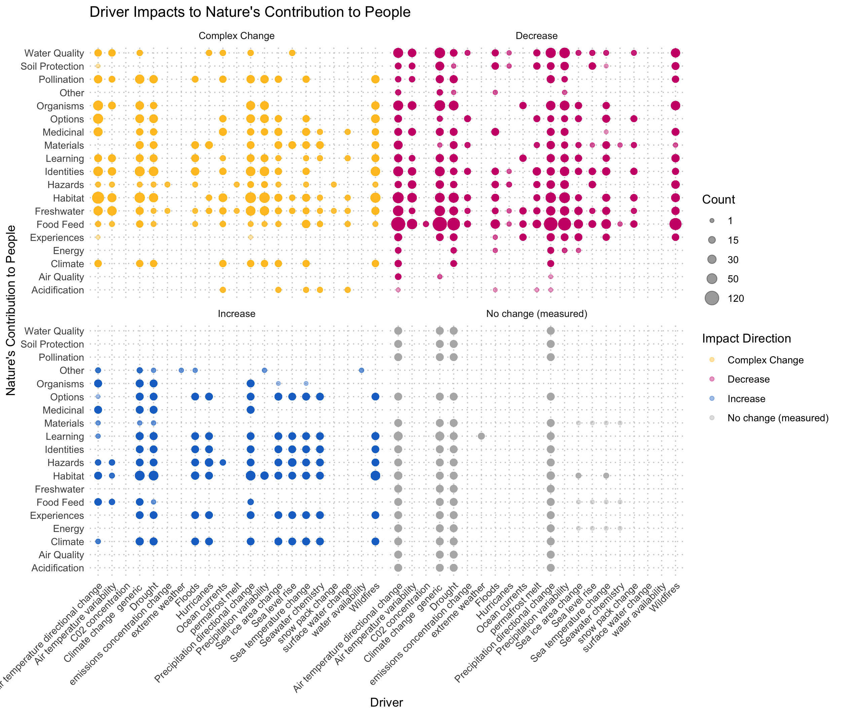

Slide 31
Should check the other
Cohesion Justice Other Relational Welfare
18 21 7 31 76
By far, the most studied element of human well-being in our study context was welfare (n = 76; ~50%), followed by relational (n=31; 20%), justice (n=21; 14%), and cohesion (n=18) dimensions of well-being (with 7 data points for other dimesions, including xxxxx).
The majority of evidence indicated decreasing welfare (86.8%) and relational well-being (64.5%) associated with climate-driven alteration of flow.
While fewer studies consider cohesion and justice, changes in justice were predominantly complex (47.6%) or decreasing (43%), with less than 10% increases, whereas the evidence for effects on cohesion were more mixed: 39% complex or decreasing, with 16.7 increasing and 5.6% with no change.
hwb n prop
<chr> <int> <dbl>
1 Cohesion 18 0.118
2 Justice 21 0.137
3 Other 7 0.0458
4 Relational 31 0.203
5 Welfare 76 0.497

Slide 32
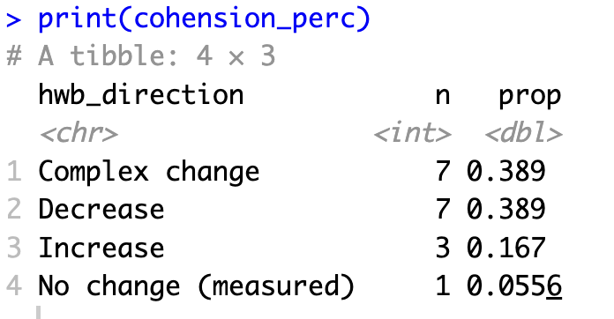
HWB trends: Cohesion

Slide 33
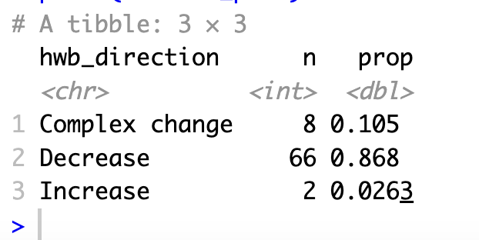
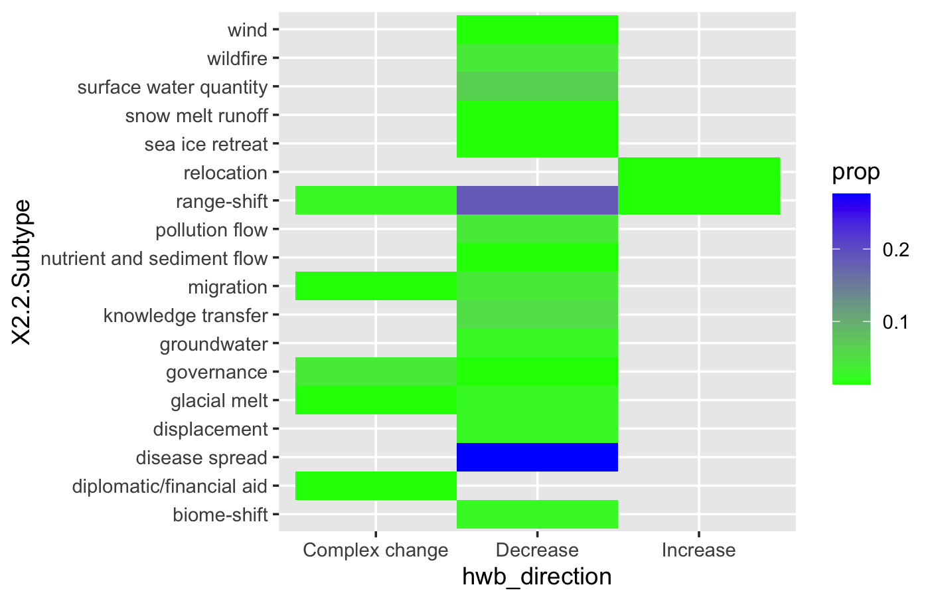
HWB trends: Welfare

Slide 34
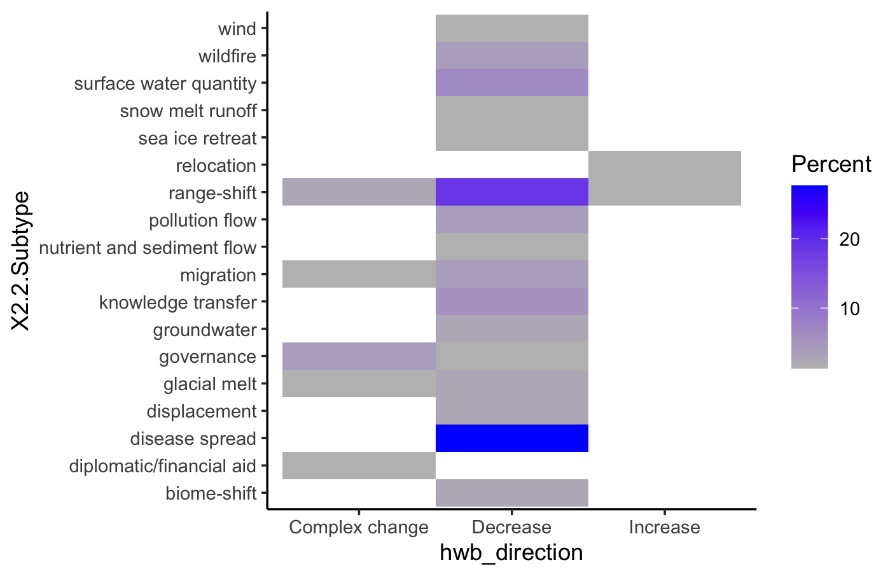

Slide 35
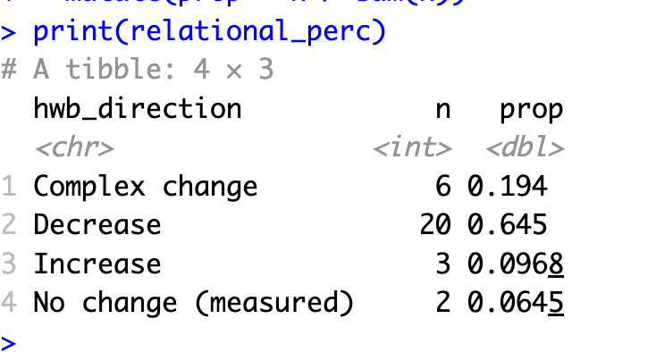
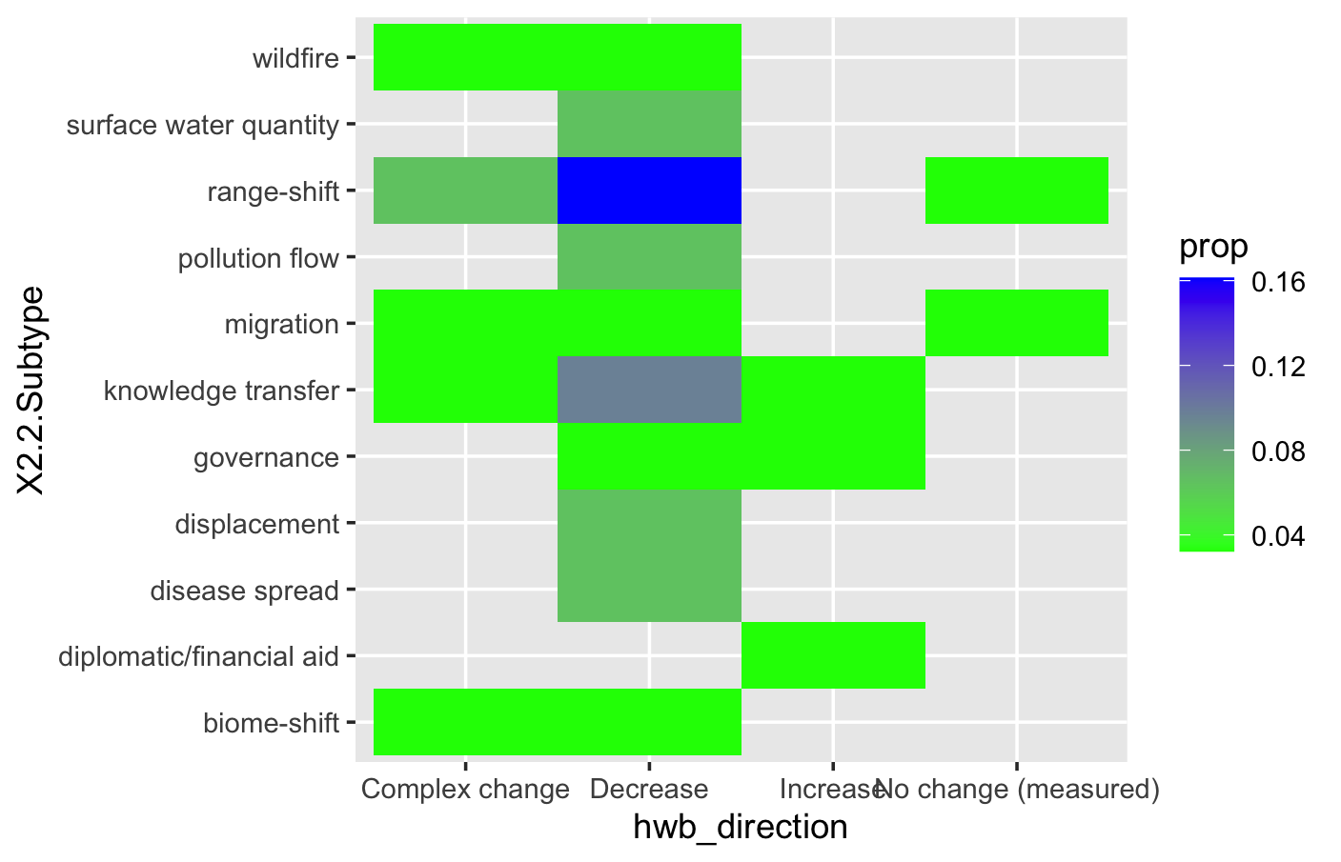
HWB trends: Relational

Slide 36
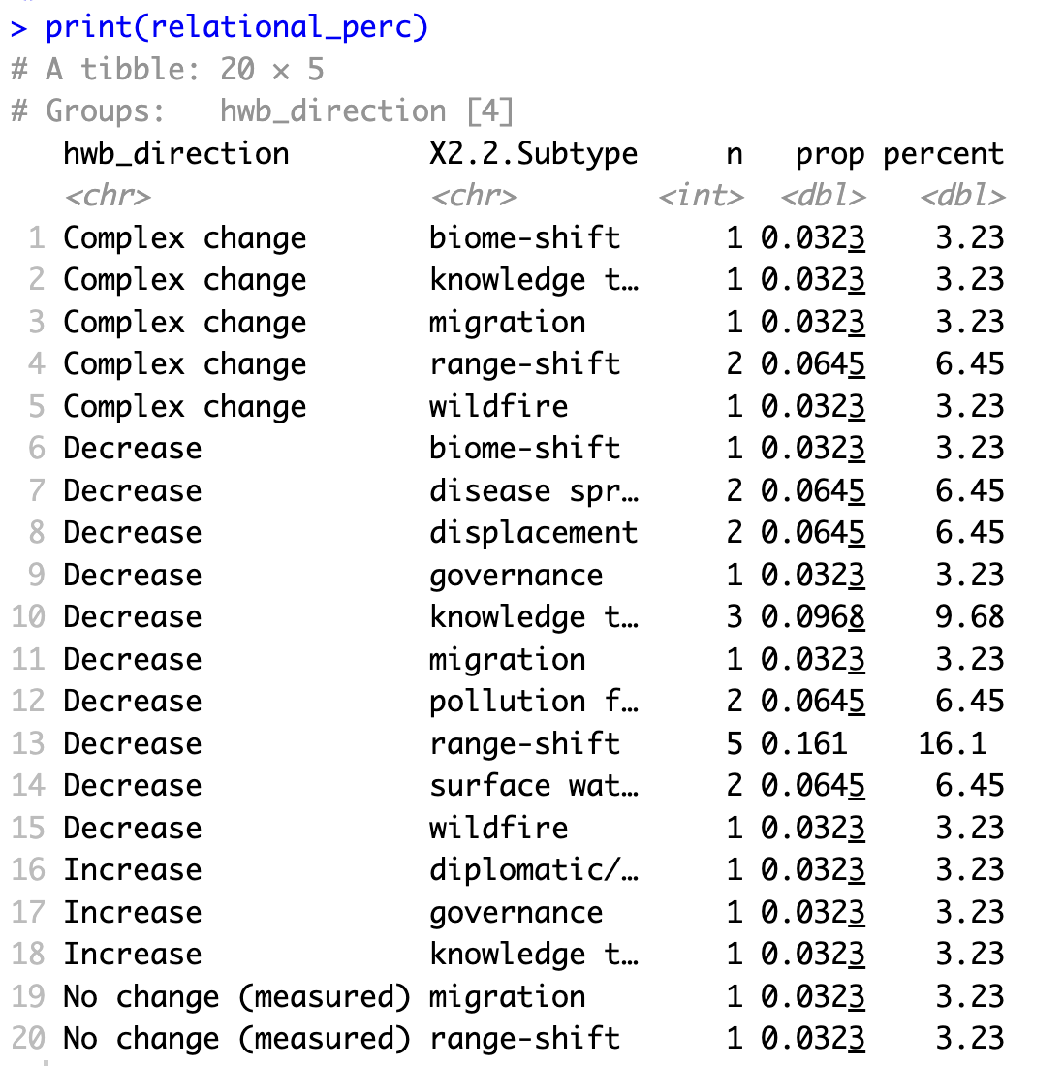

HWB trends: Relational

Slide 37
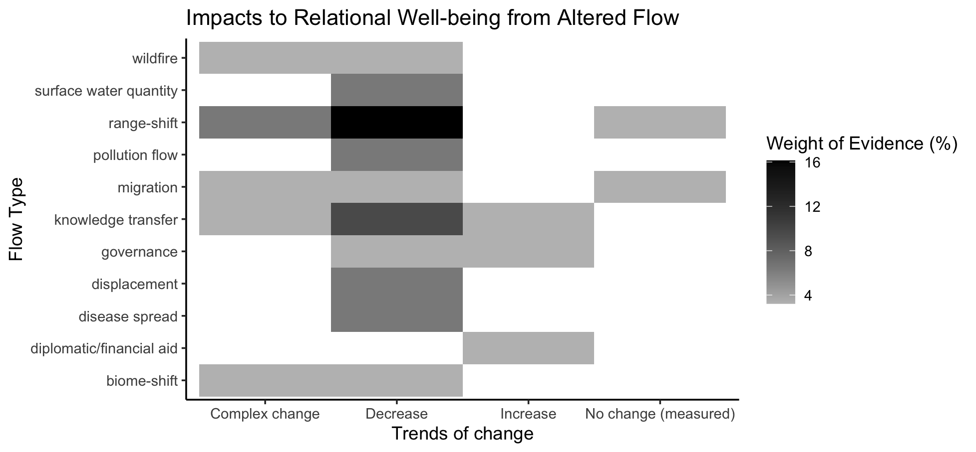
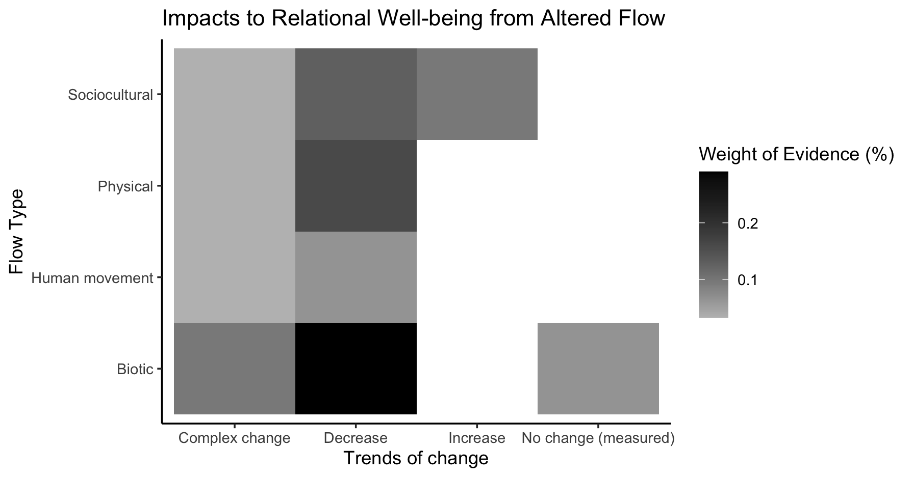
Relational

Slide 38
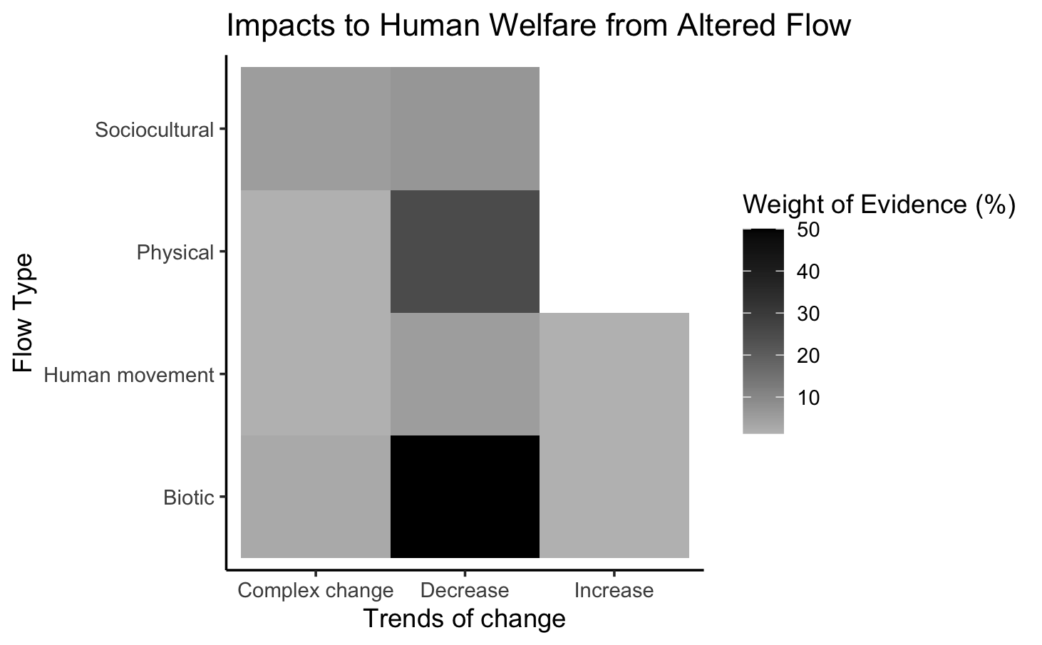
Welfare

Slide 39
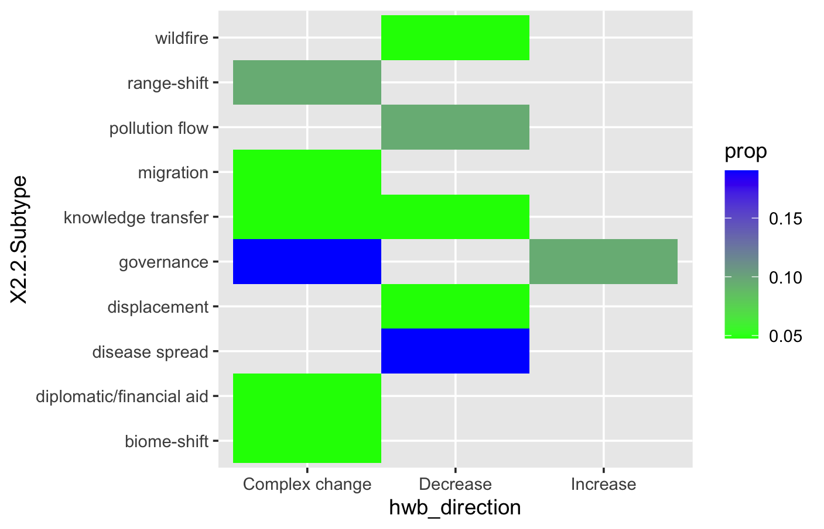
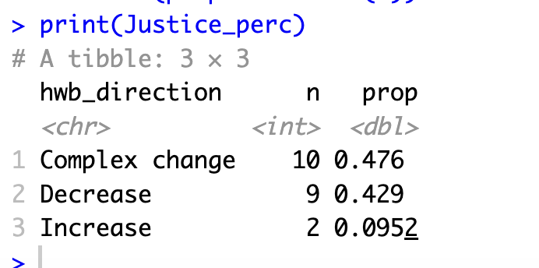
HWB trends: Justice

Slide 40
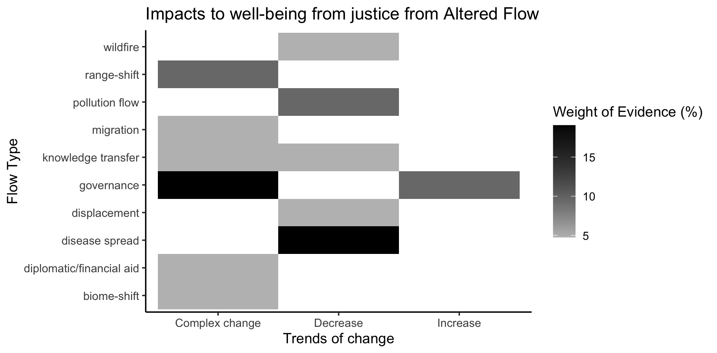

Slide 41
Other hwb in otherhwb.txt

Slide 42
Table 1. Summary of evidence for changes in dimensions of human well-being and knowledge gaps.
Trend type | Well- Established Decreasing | Established Decreasing | Well- Established Complex Changes and Decreasing | Established Complex Changes and Decreasing | Mixed Evidence | Insufficient Evidence
Category | Welfare Relational well-being
n

Slide 43
OLDER:

Slide 45
At least 5 entries – top – to get stats on % of entries or papers on these:

Slide 46
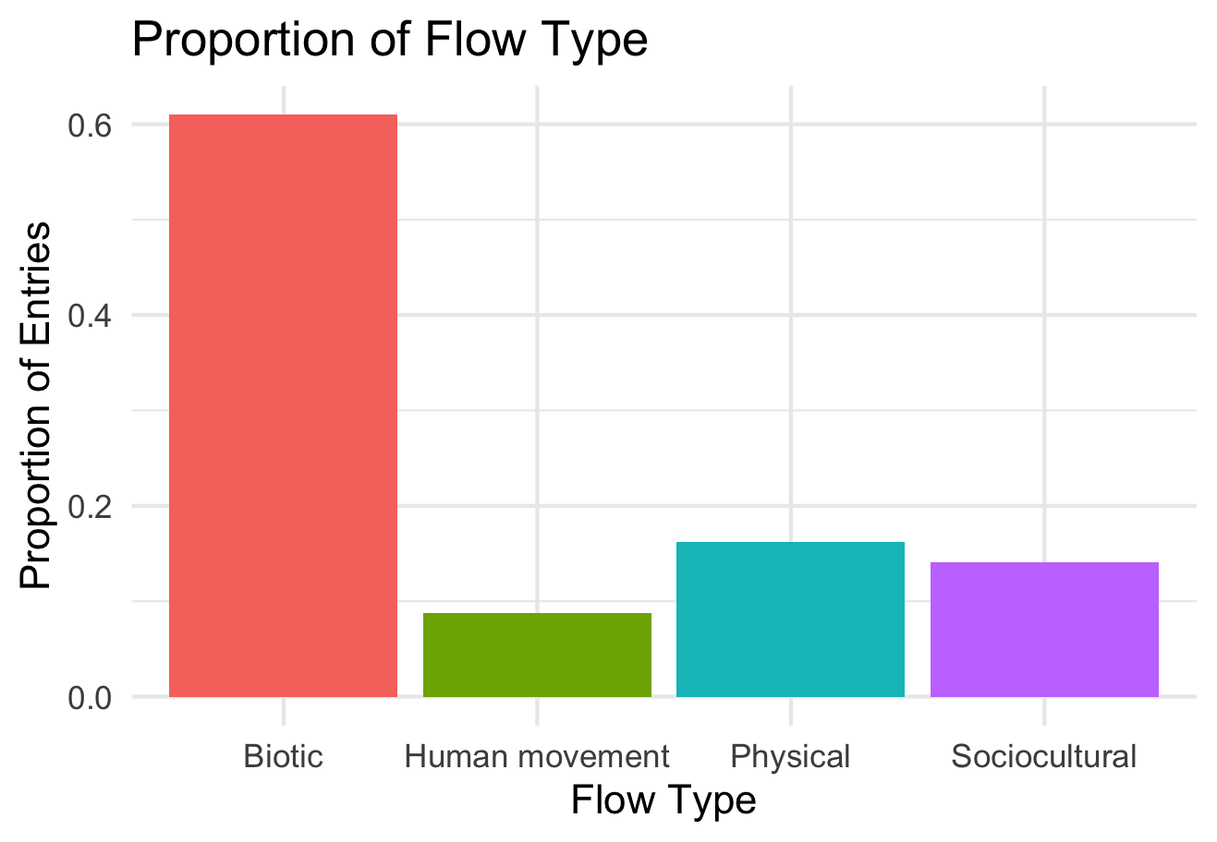

Slide 47
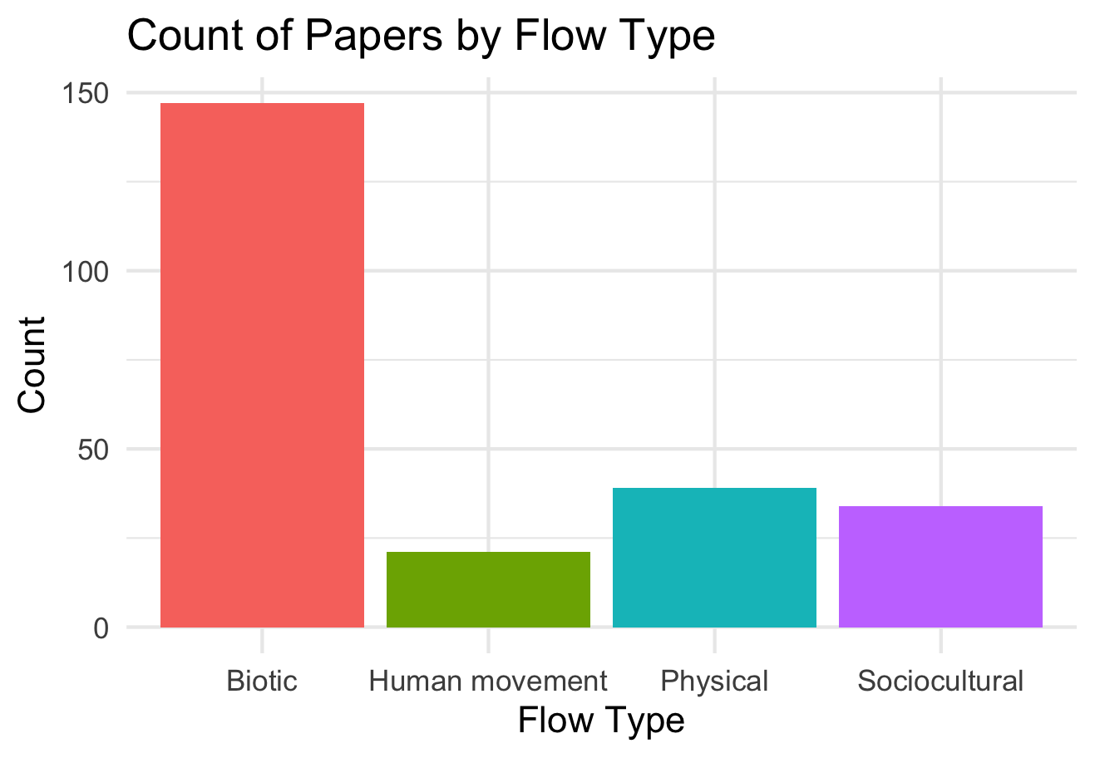

Slide 48
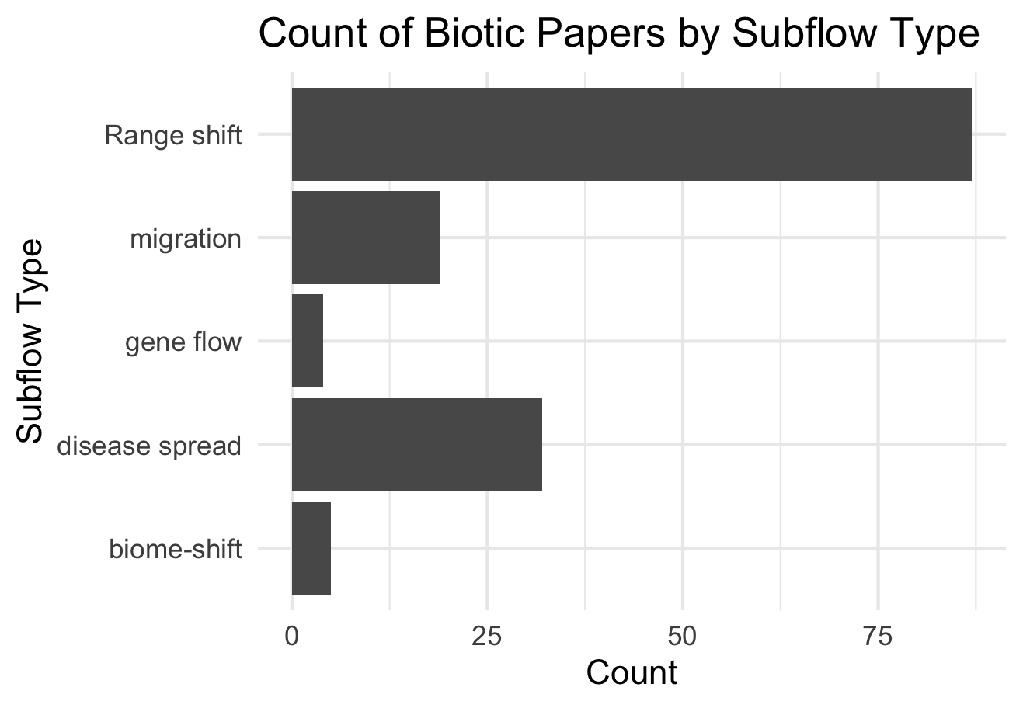

Slide 49
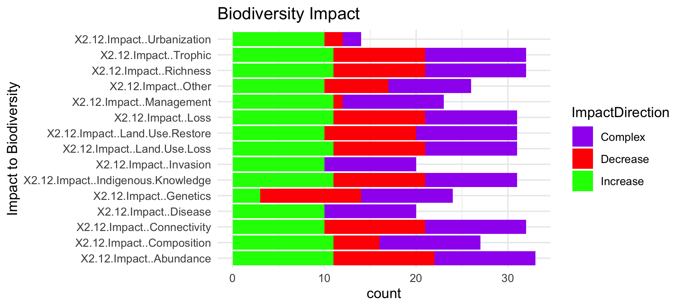

Slide 51
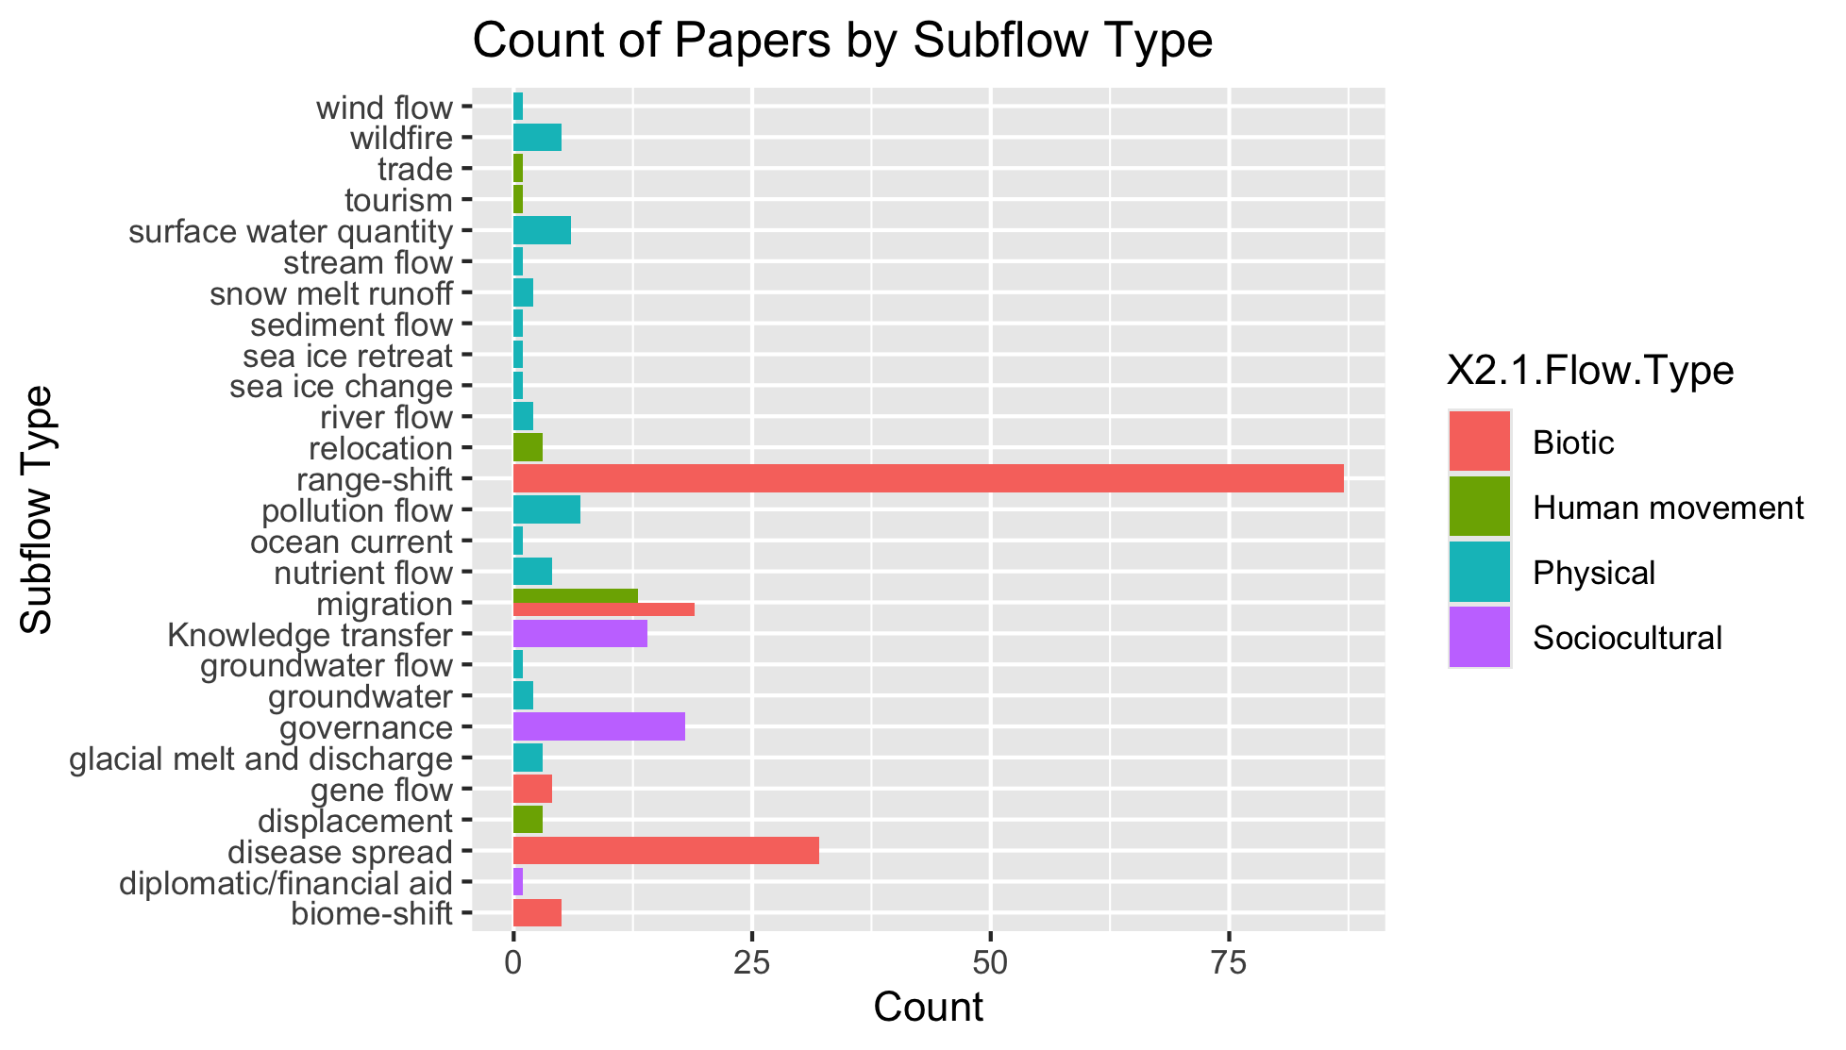
To group physical flow papers

Slide 52
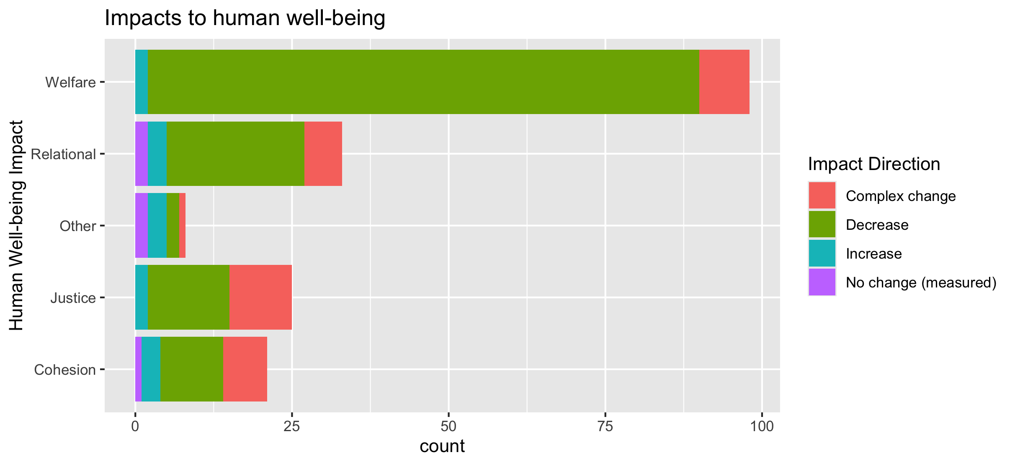
To align direction colors with final color pallet

Slide 53
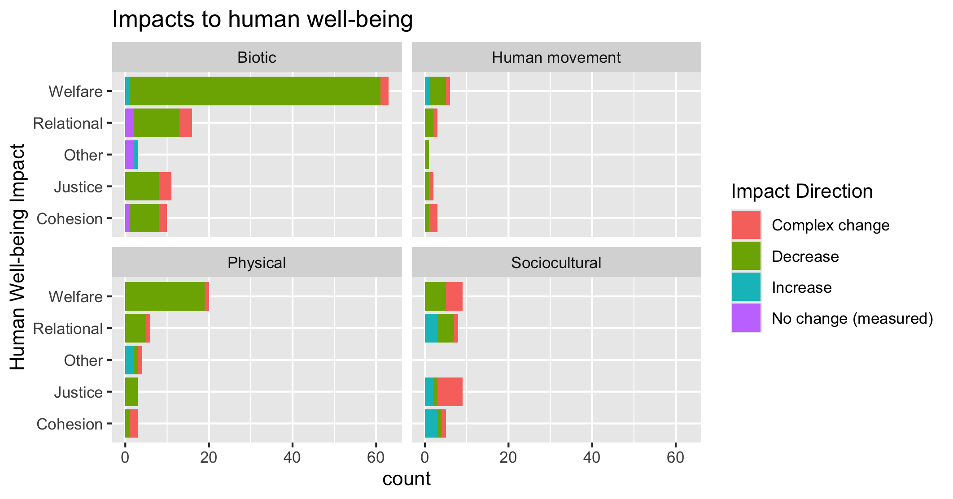
To align direction colors with final color pallet

Slide 54
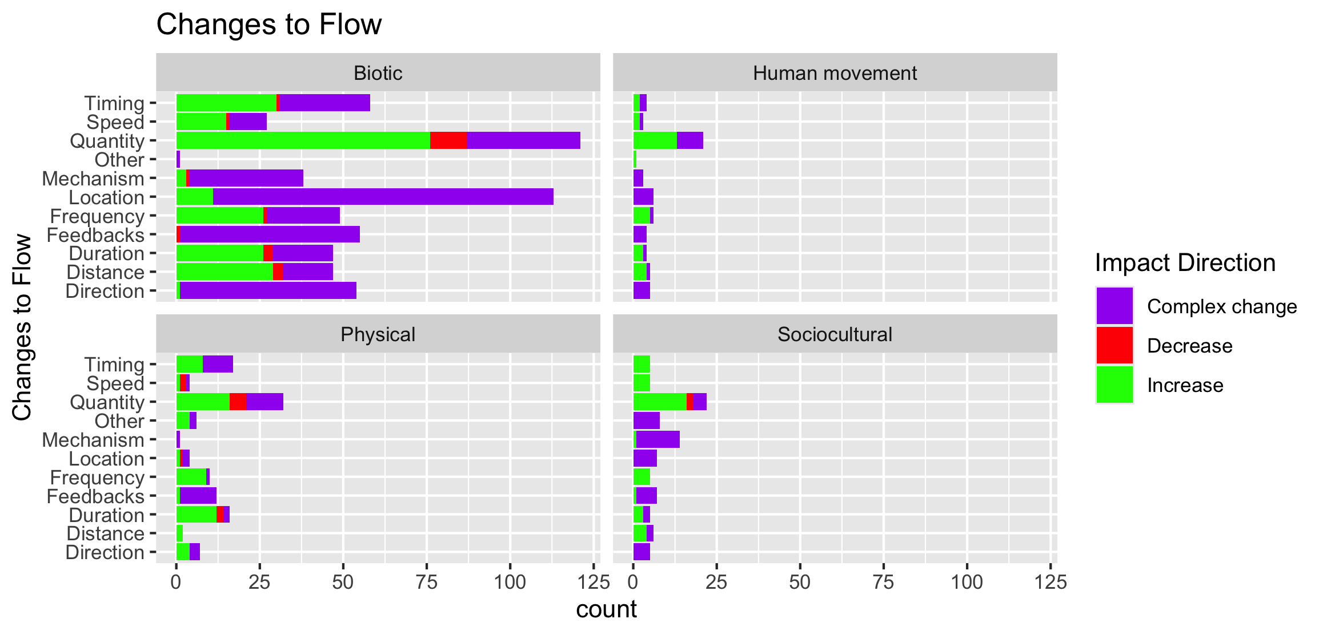

Slide 55
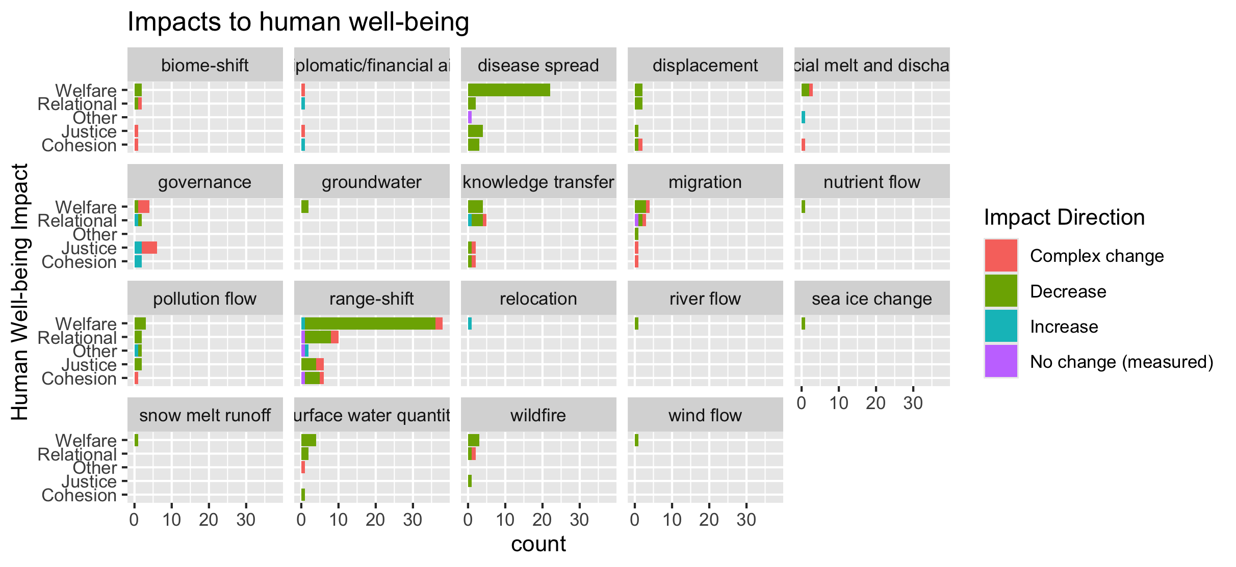
To group physical flow papers

Slide 56
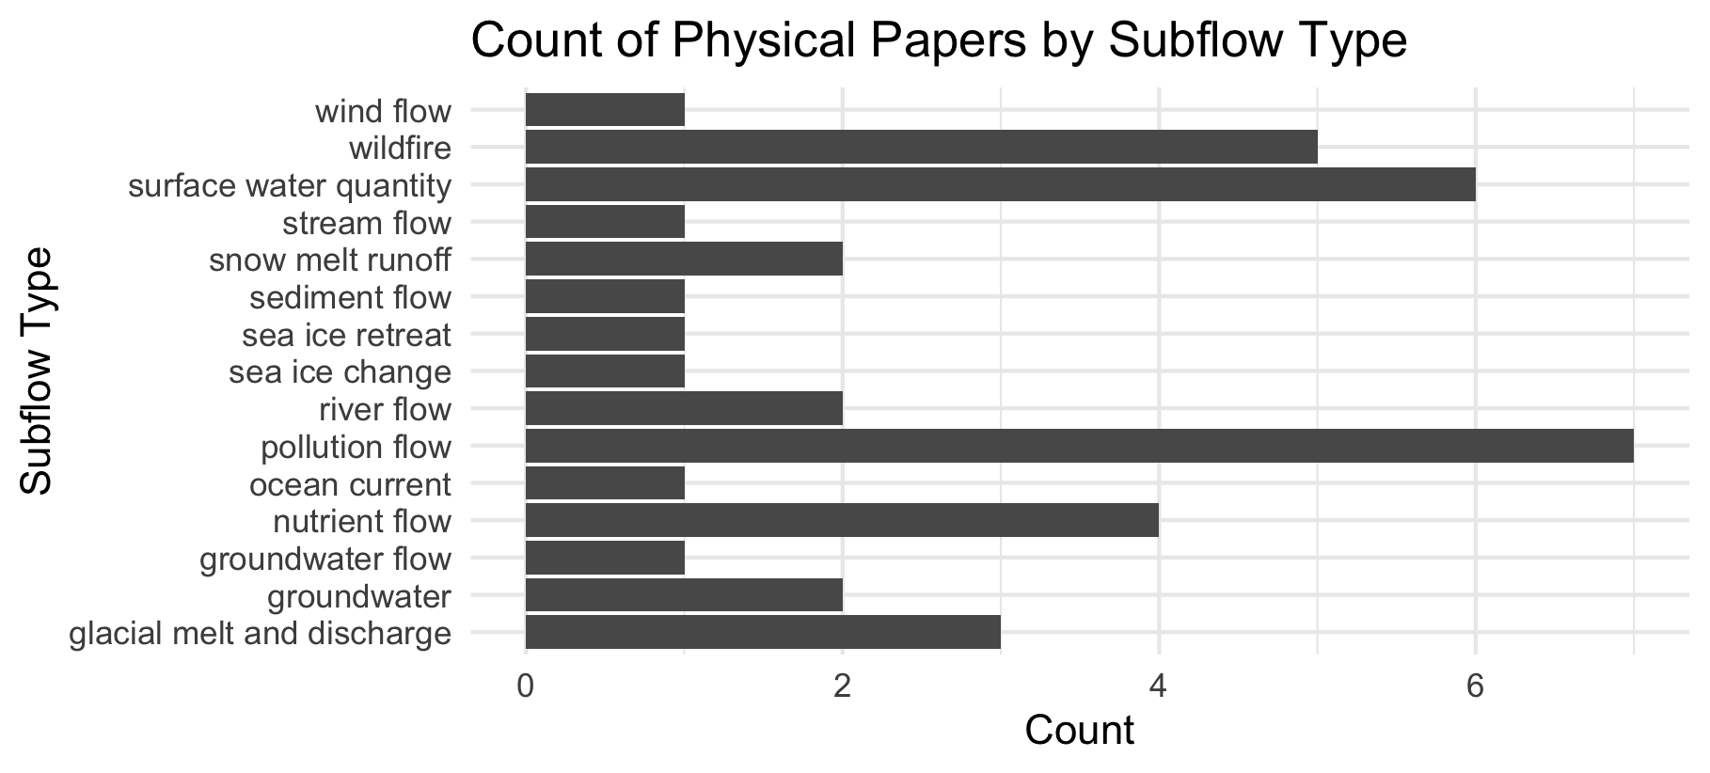

Slide 57
Feb 23 2025

Slide 58
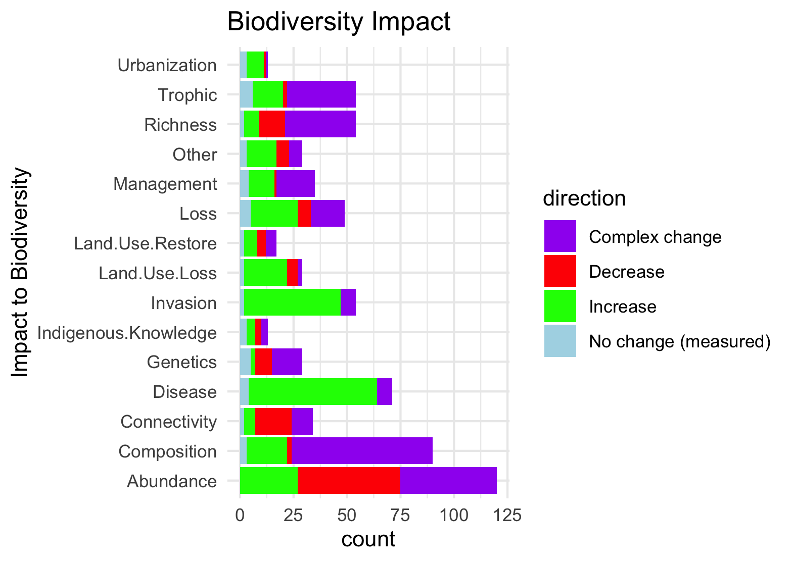
Needs to be grouped by what is good and what is bad to see increase in:

Slide 59

Scale free on the facet (diff x axis)

Slide 60

Scale fixed on the facet (same x axis)

Slide 61


Slide 62

Colleen: see note isn the code – we could group spme of the drivers (hurricaines, extreme weather, ands ome of the ice ones). This still doesnt take into account if changes arw good or bad though and might just be too busy.

Slide 63

#not that informative because so many more of the papers are biotic

Slide 64
NCPs

Slide 65

Fix labels

Slide 66
Do by flow type

Slide 67
Fix labels

Slide 68


Slide 69

Too many drivers

Slide 70


Slide 71
HWB

Slide 72
Connections – how does altered flow relate
Driver~ altered flow (by flow, and subflow – grouped out by flow
Altered flow~ impact (for each category)

Slide 73
Range shifts and NCP – Laura’s desired paper 2

Slide 74


